Slide 1
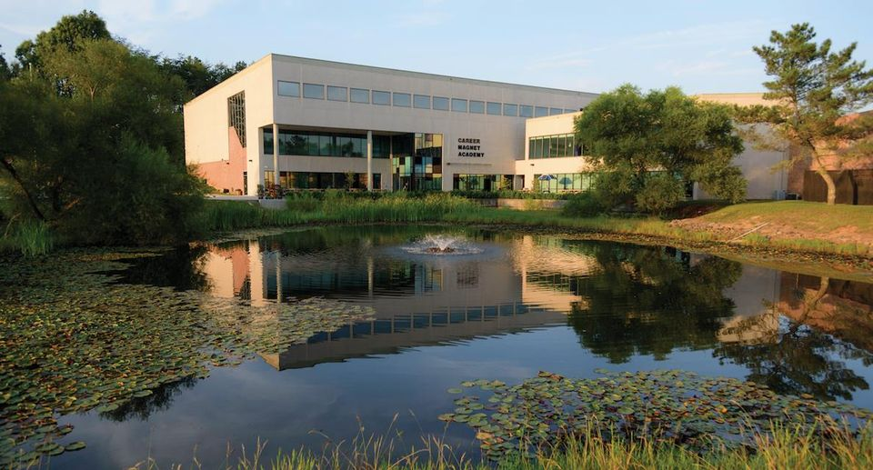

Career Magnet Academy
KNOX COUNTY SCHOOLS

Slide 2
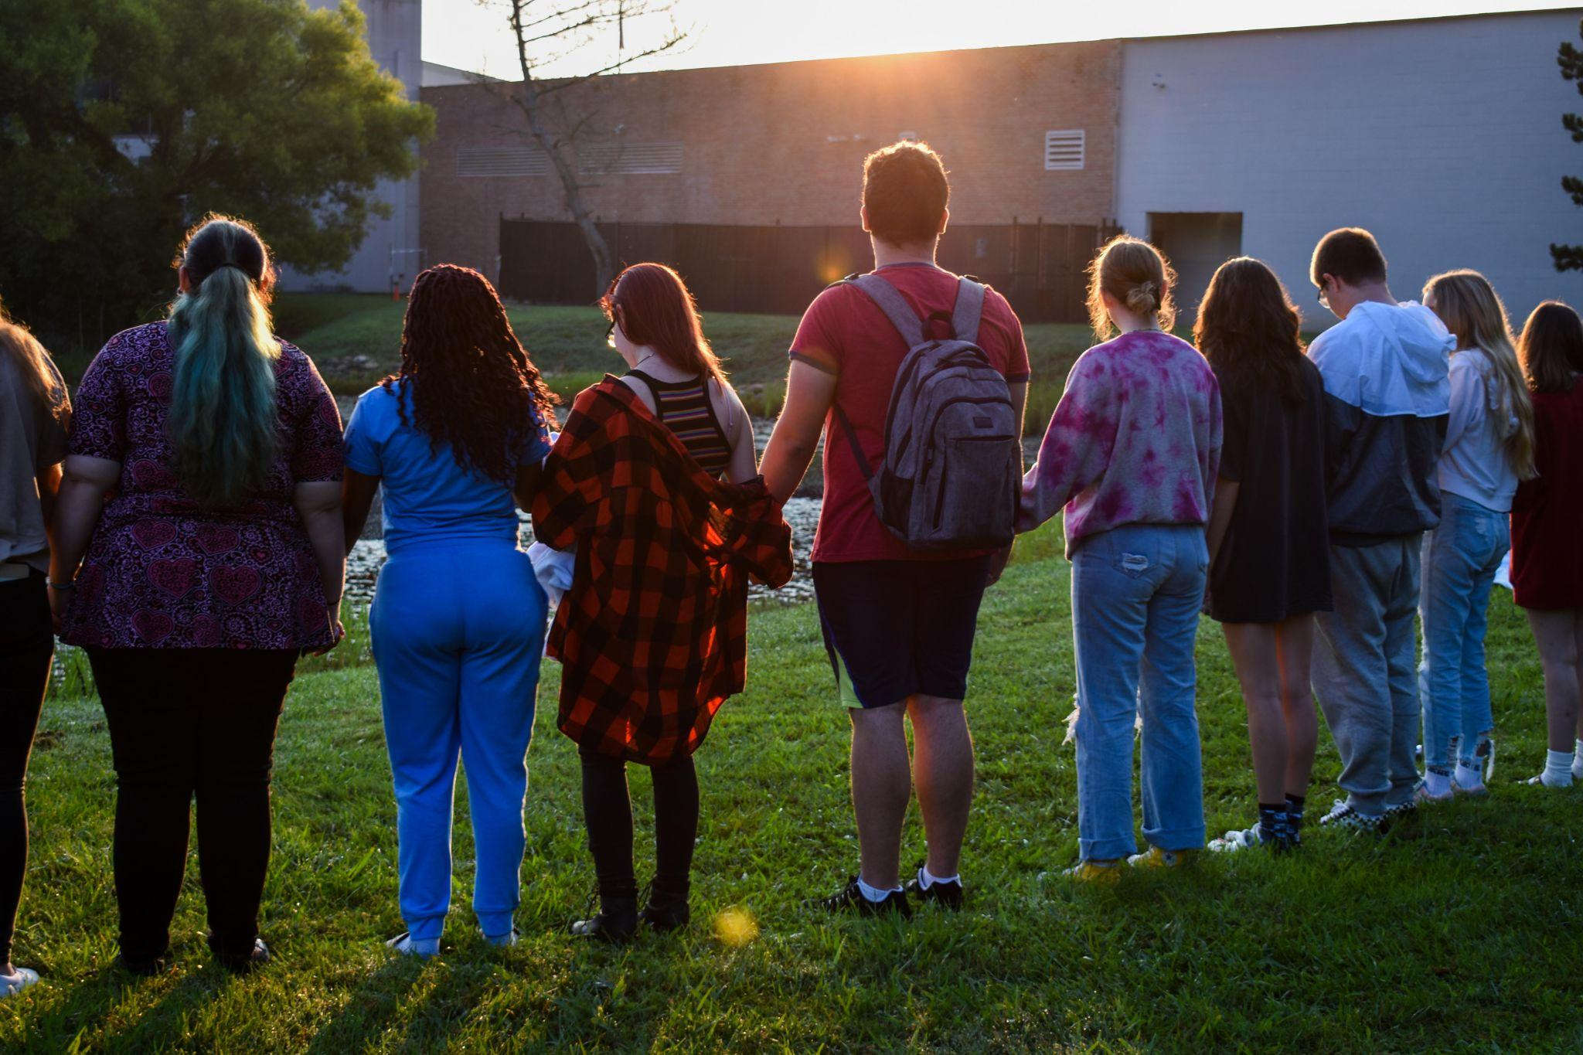
WHO ARE WE?
We are a Knox County Magnet school who partners with Pellissippi State Community College in order to provide our scholars an opportunity to make significant progress towards an Associate’s degree while they are in high school
Notes:
Leanne

Slide 3
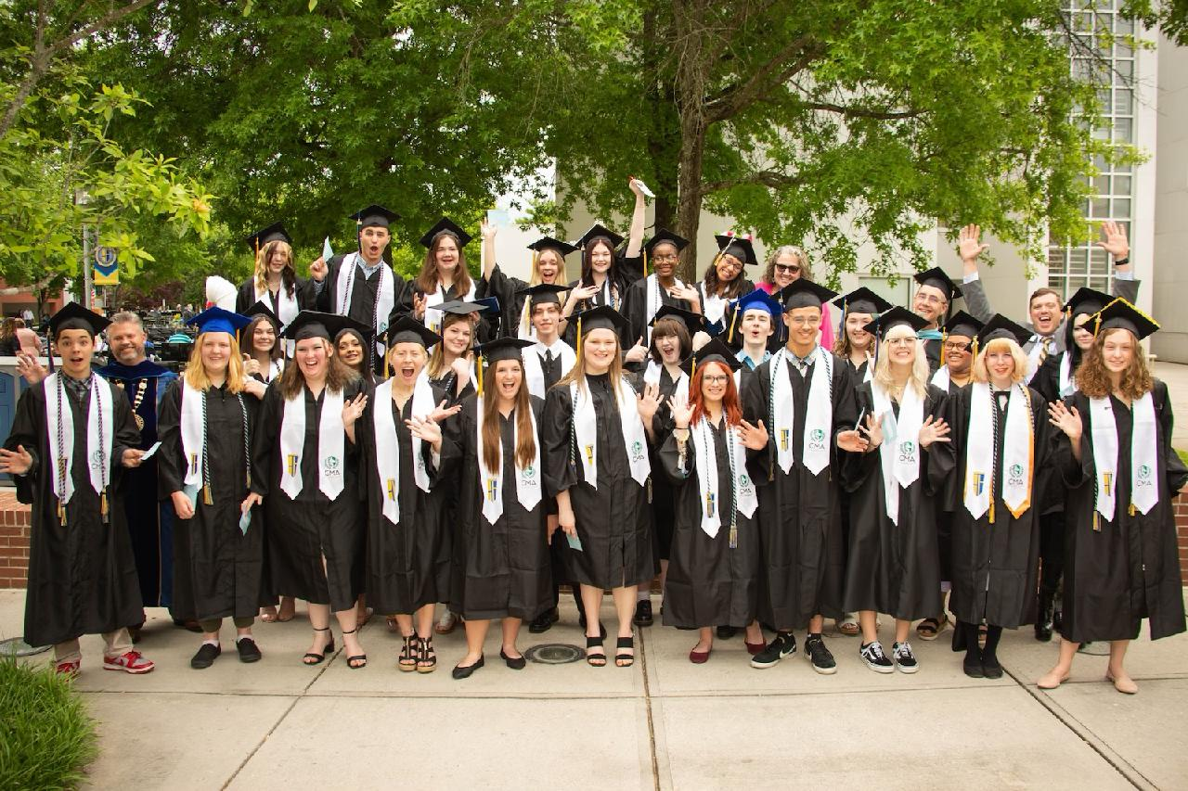
MAGNET PROGRAMMING
Dual Enrollment
Full access to PSCC courses
  Meet benchmarks
  Graduation requirements
No direct cost
  Dual enrollment grant
Online, evening, and summer courses available
28 Associate Degrees earned 22-23
Notes:
Leanne

Slide 4
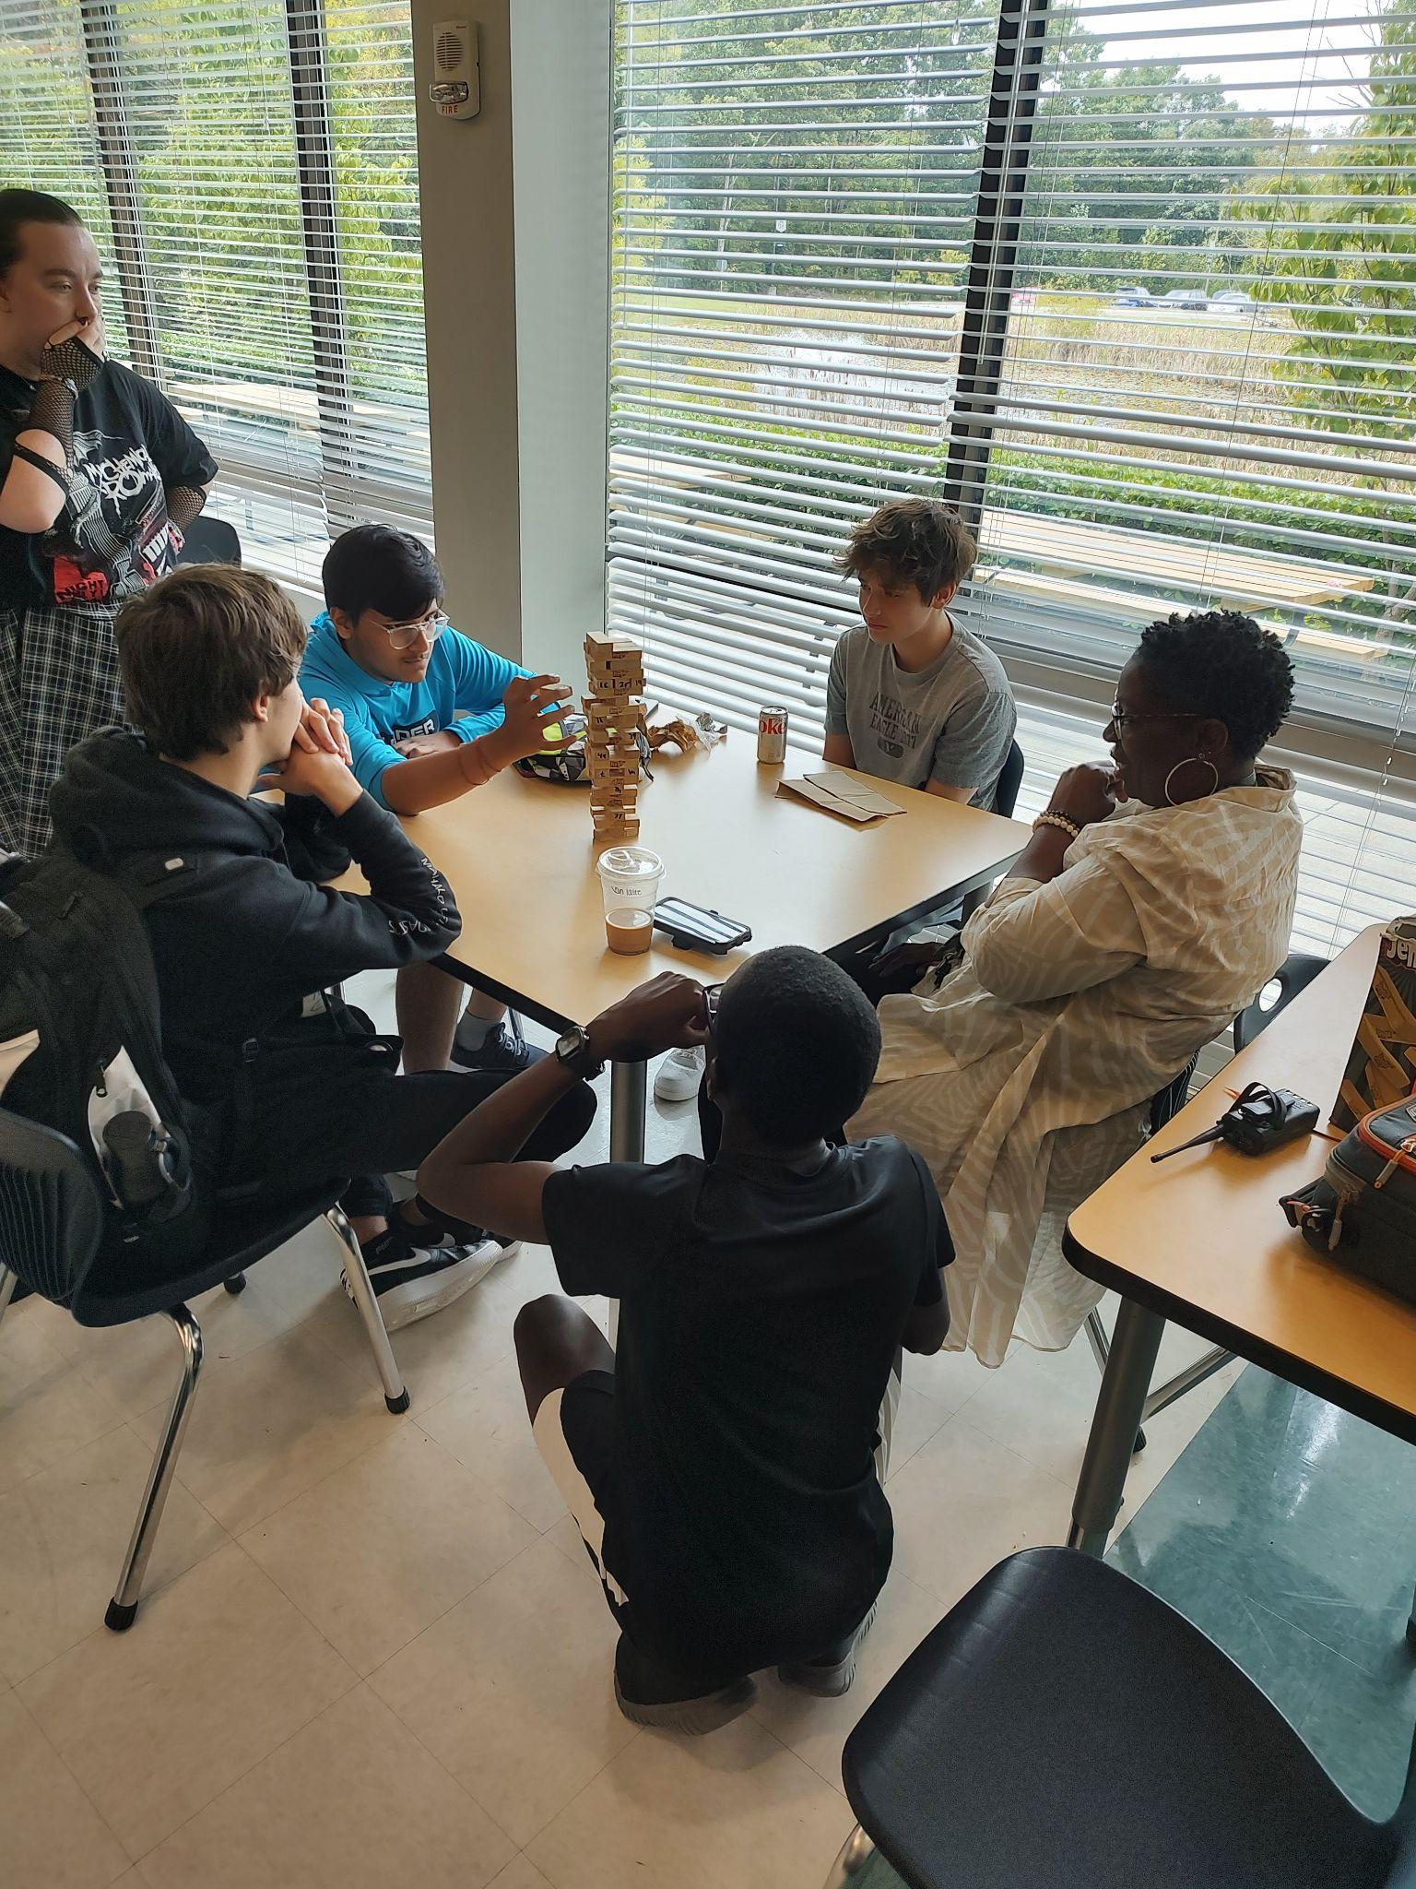
OUR VALUES
Diploma+
Collaboration
Creativity
Critical Thinking
Problem Solving
Leadership
Notes:
Leanne

Slide 5
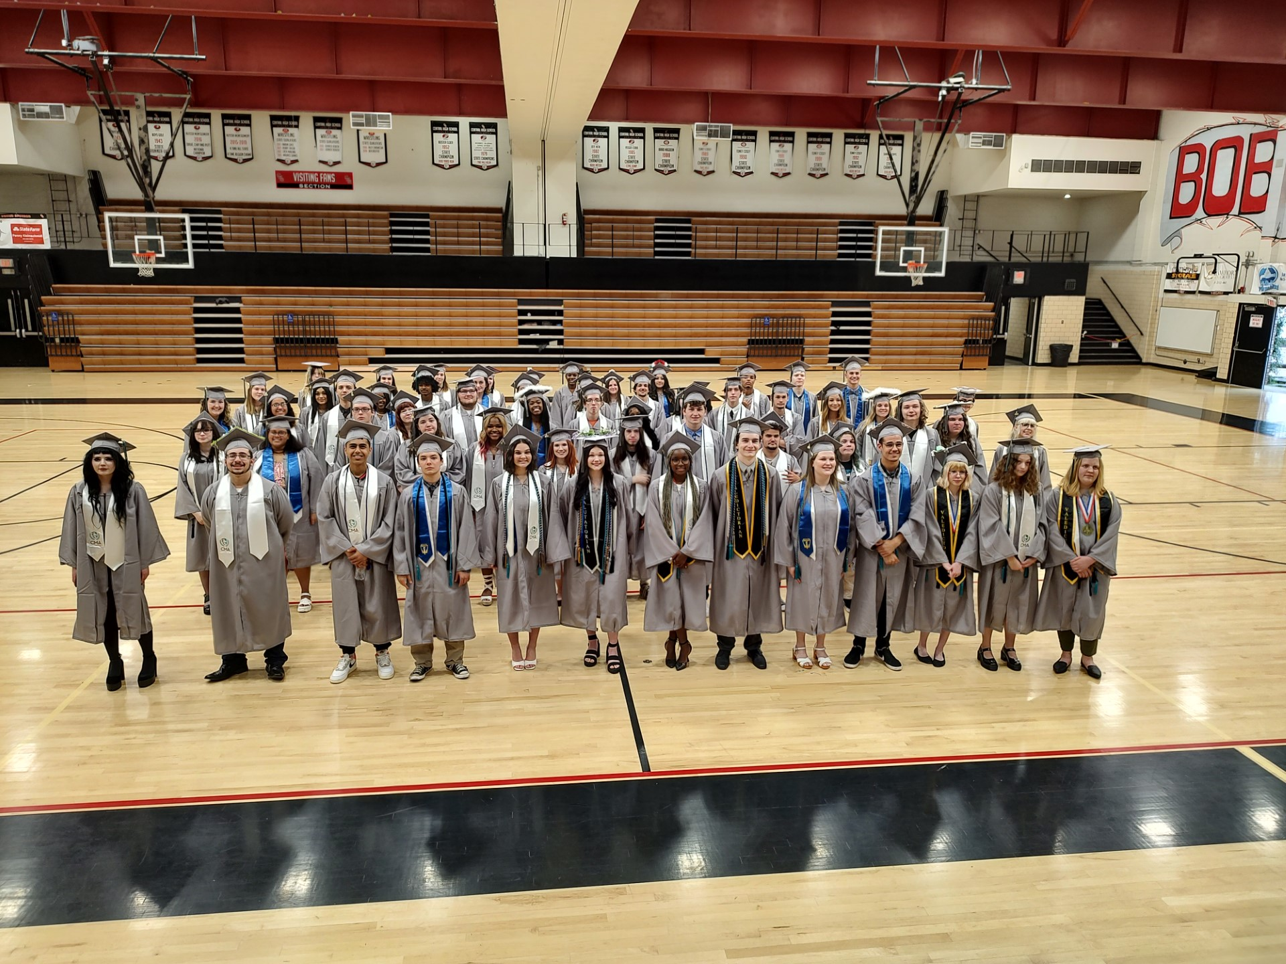
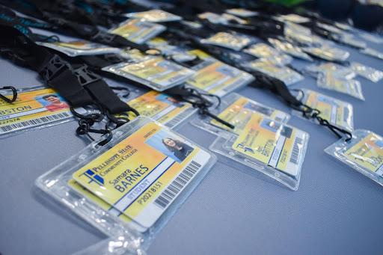
2022-2023 DUAL ENROLLMENT DATA
Total of 1580 credit hours, 526 college courses, saving our parents over $260,000 in college tuition!!
Notes:
Leanne

Slide 6
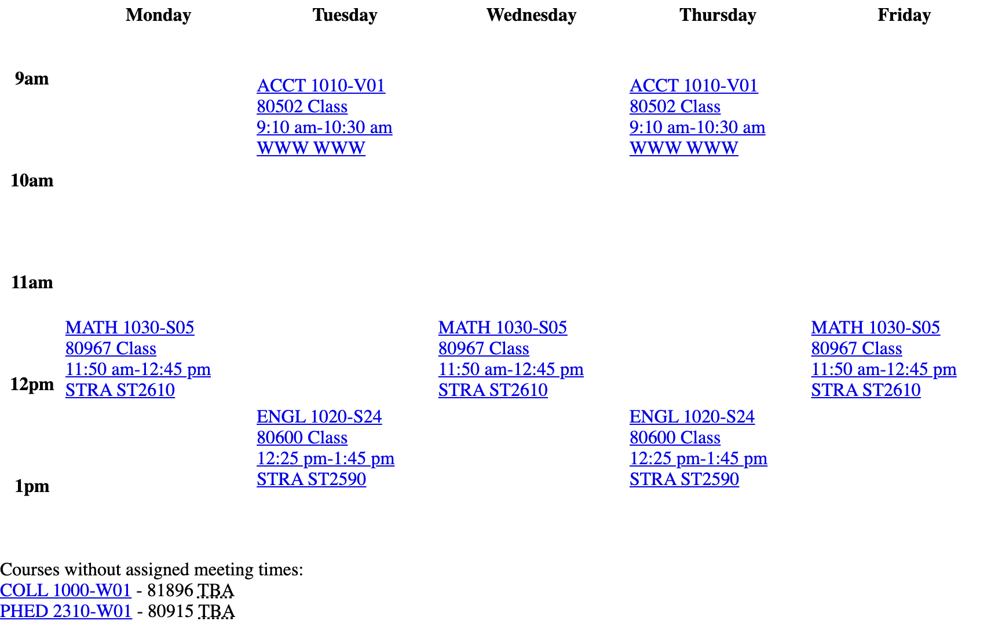
SENIOR CMA SCHEDULE

Slide 7
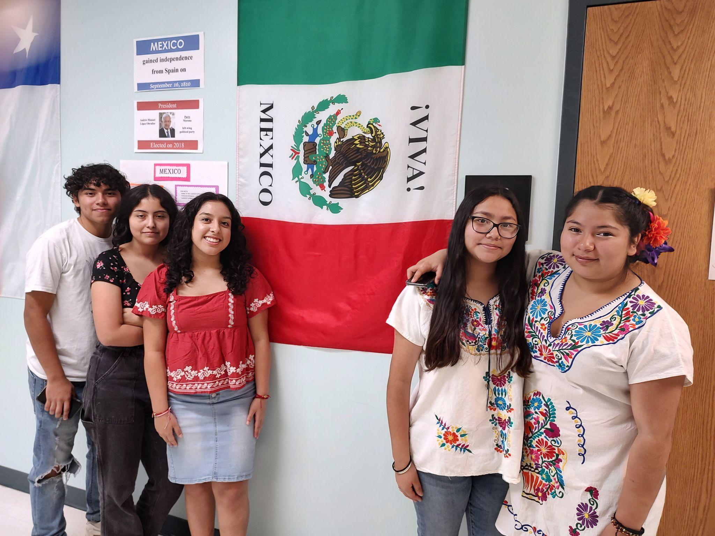
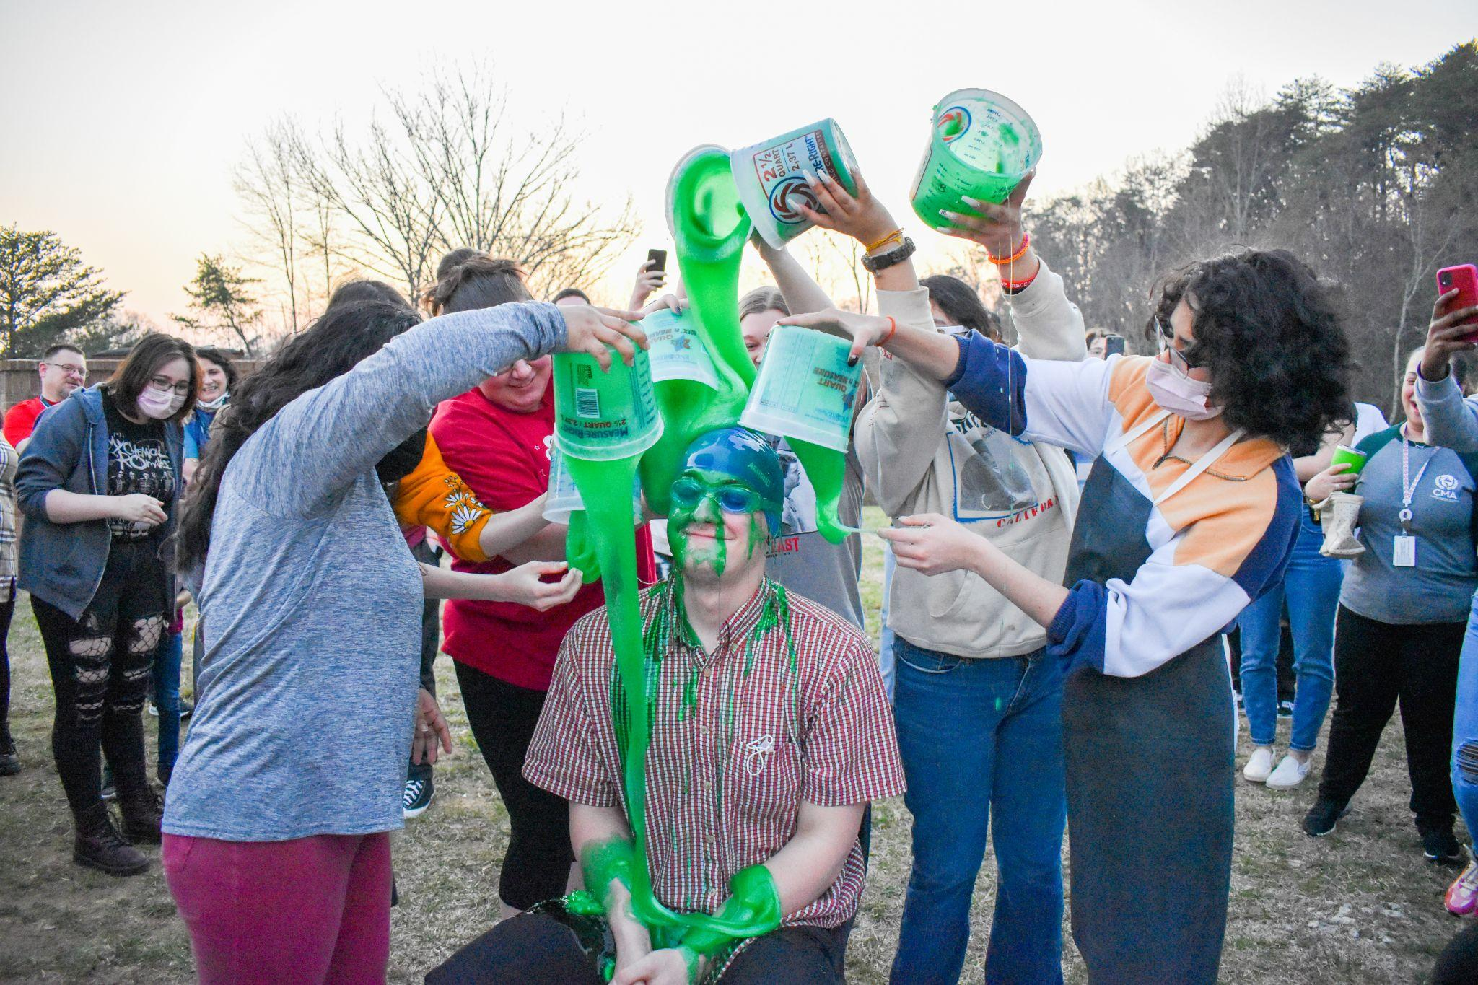
THE WOLFPACK FAMILY
117 Freshmen
98 Sophomores
61 Juniors
73 Seniors
349 Total Students
Notes:
Leanne

Slide 8

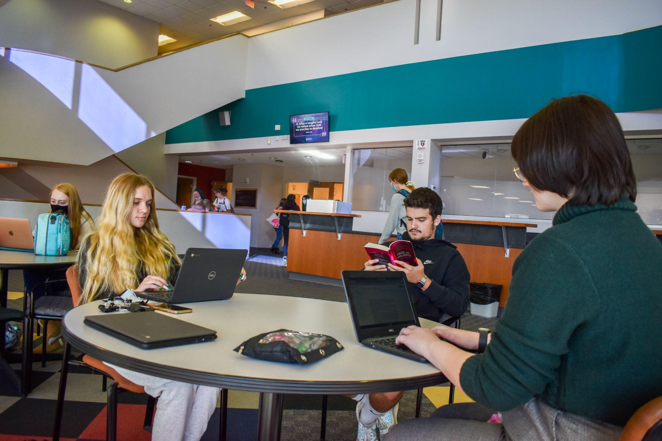
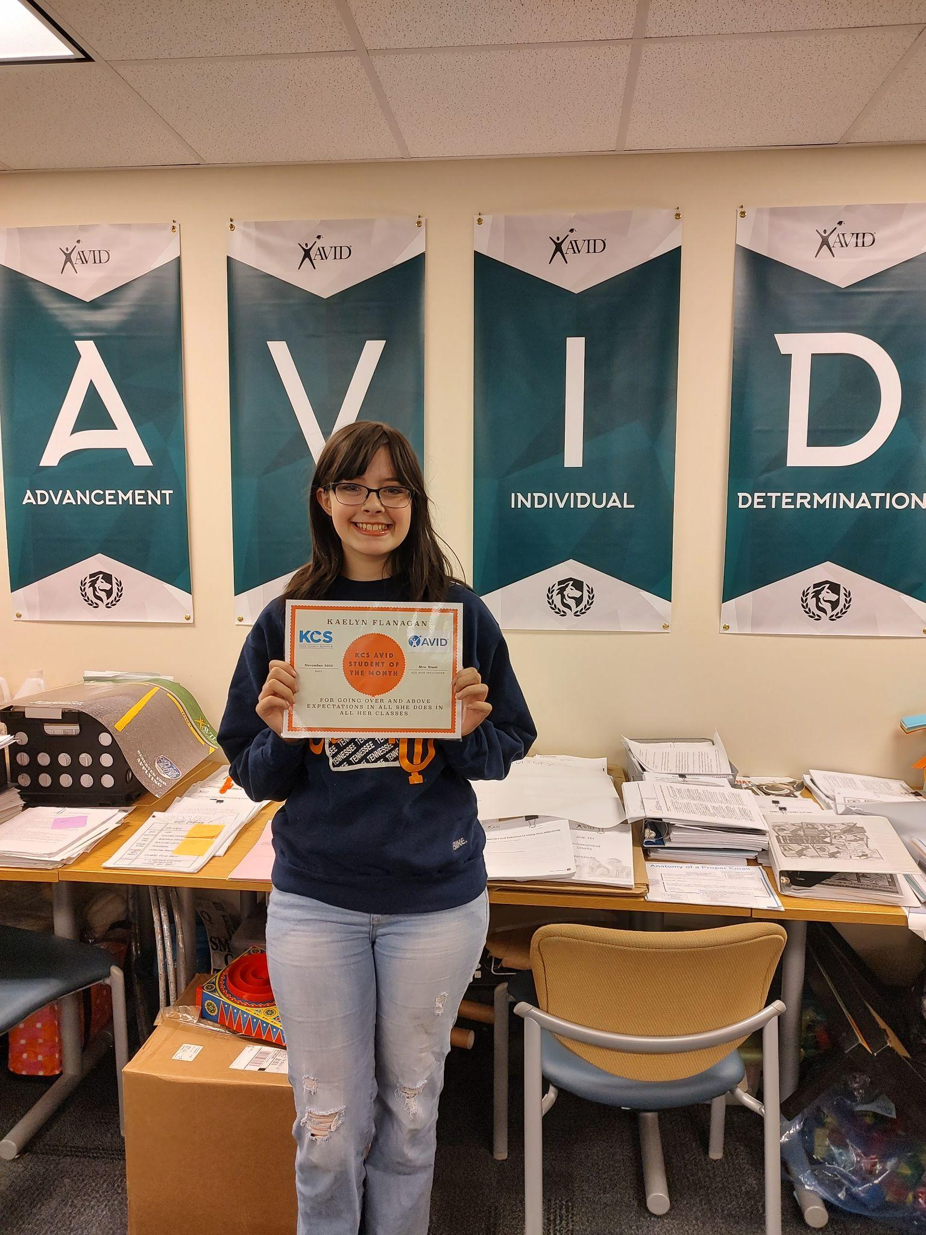
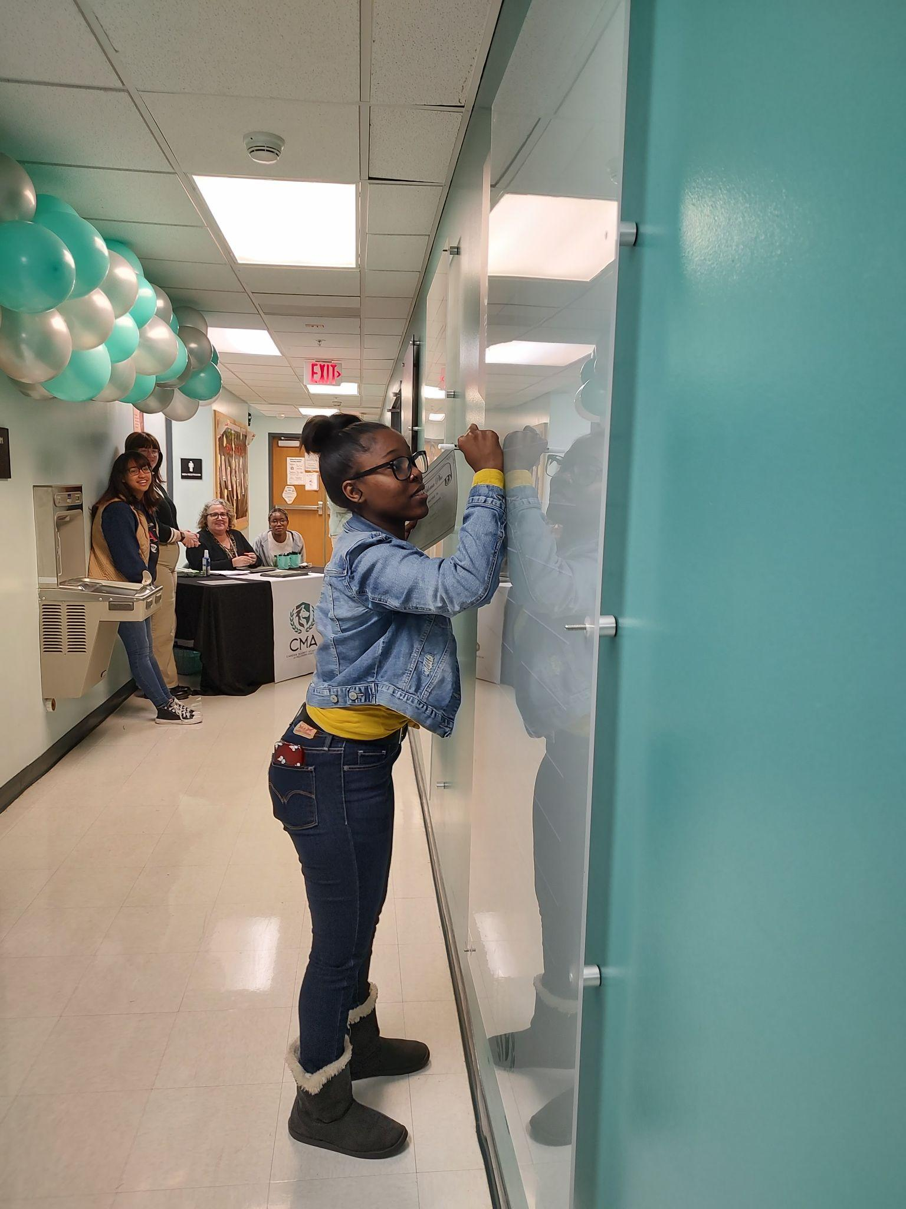
MAGNET PROGRAMMING
College Readiness
AVID
College Seminar
ACT Prep
Notes:
Leanne

Slide 9

DIVERSE STUDENT BODY
Students from every middle school in Knox County
Homeschooled students
Montessori students
Private school students
First-generation college students
Notes:
Leanne

Slide 10
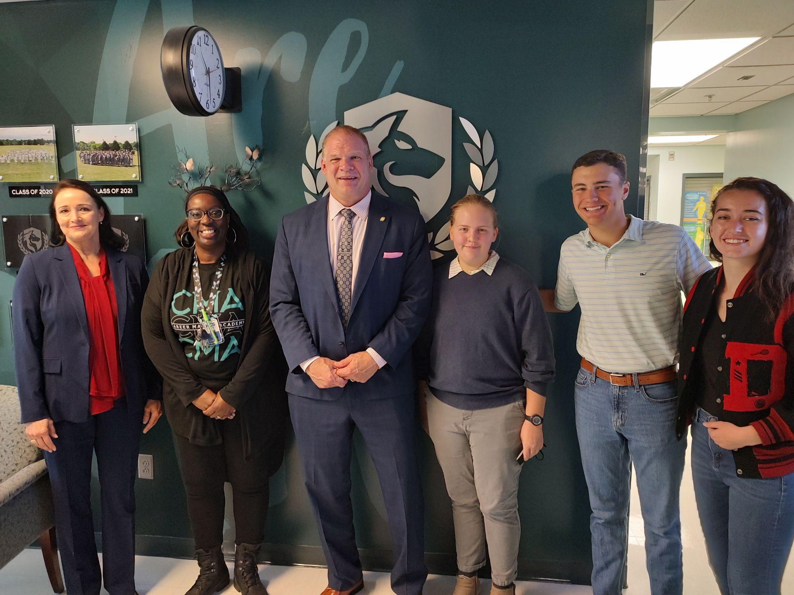
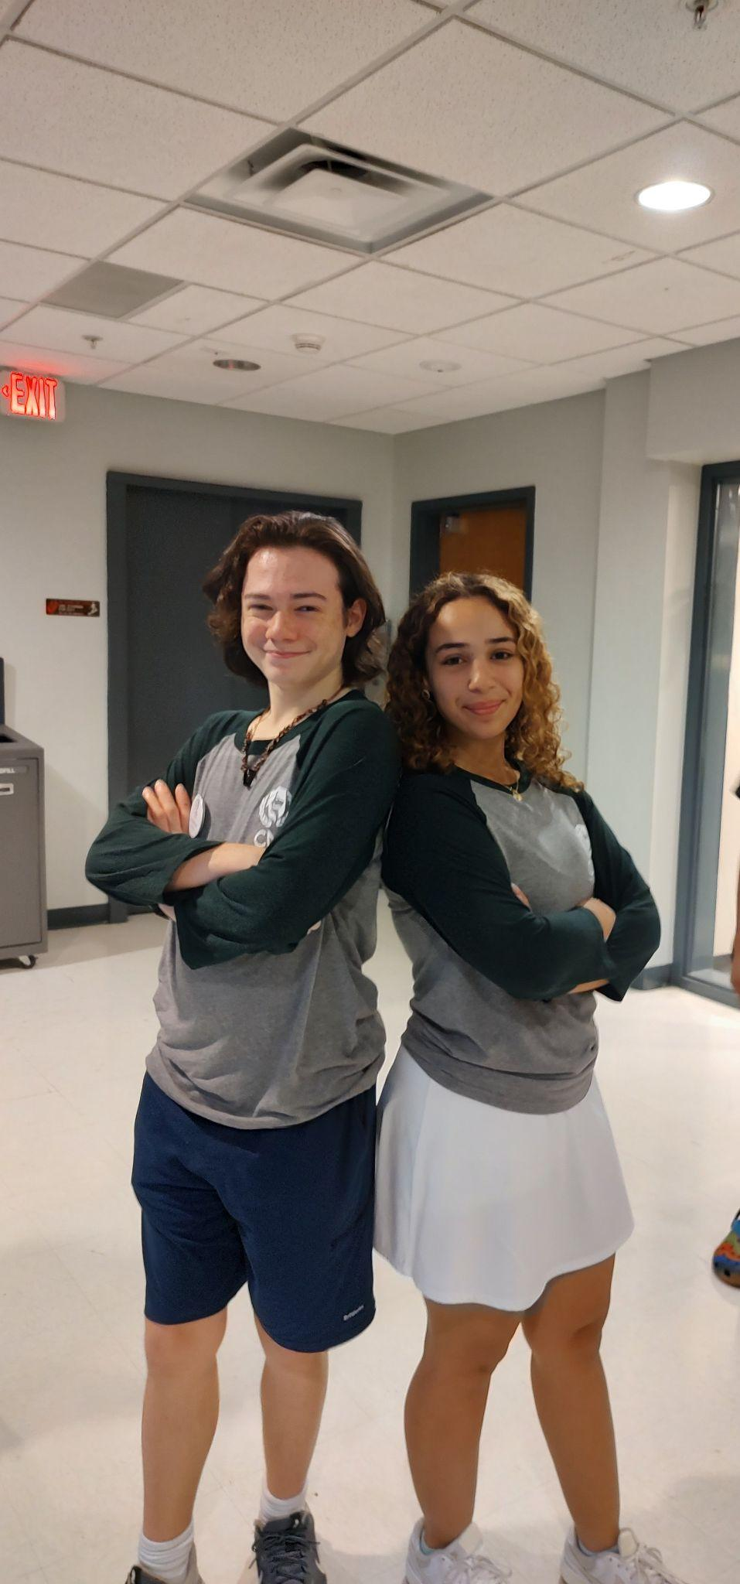
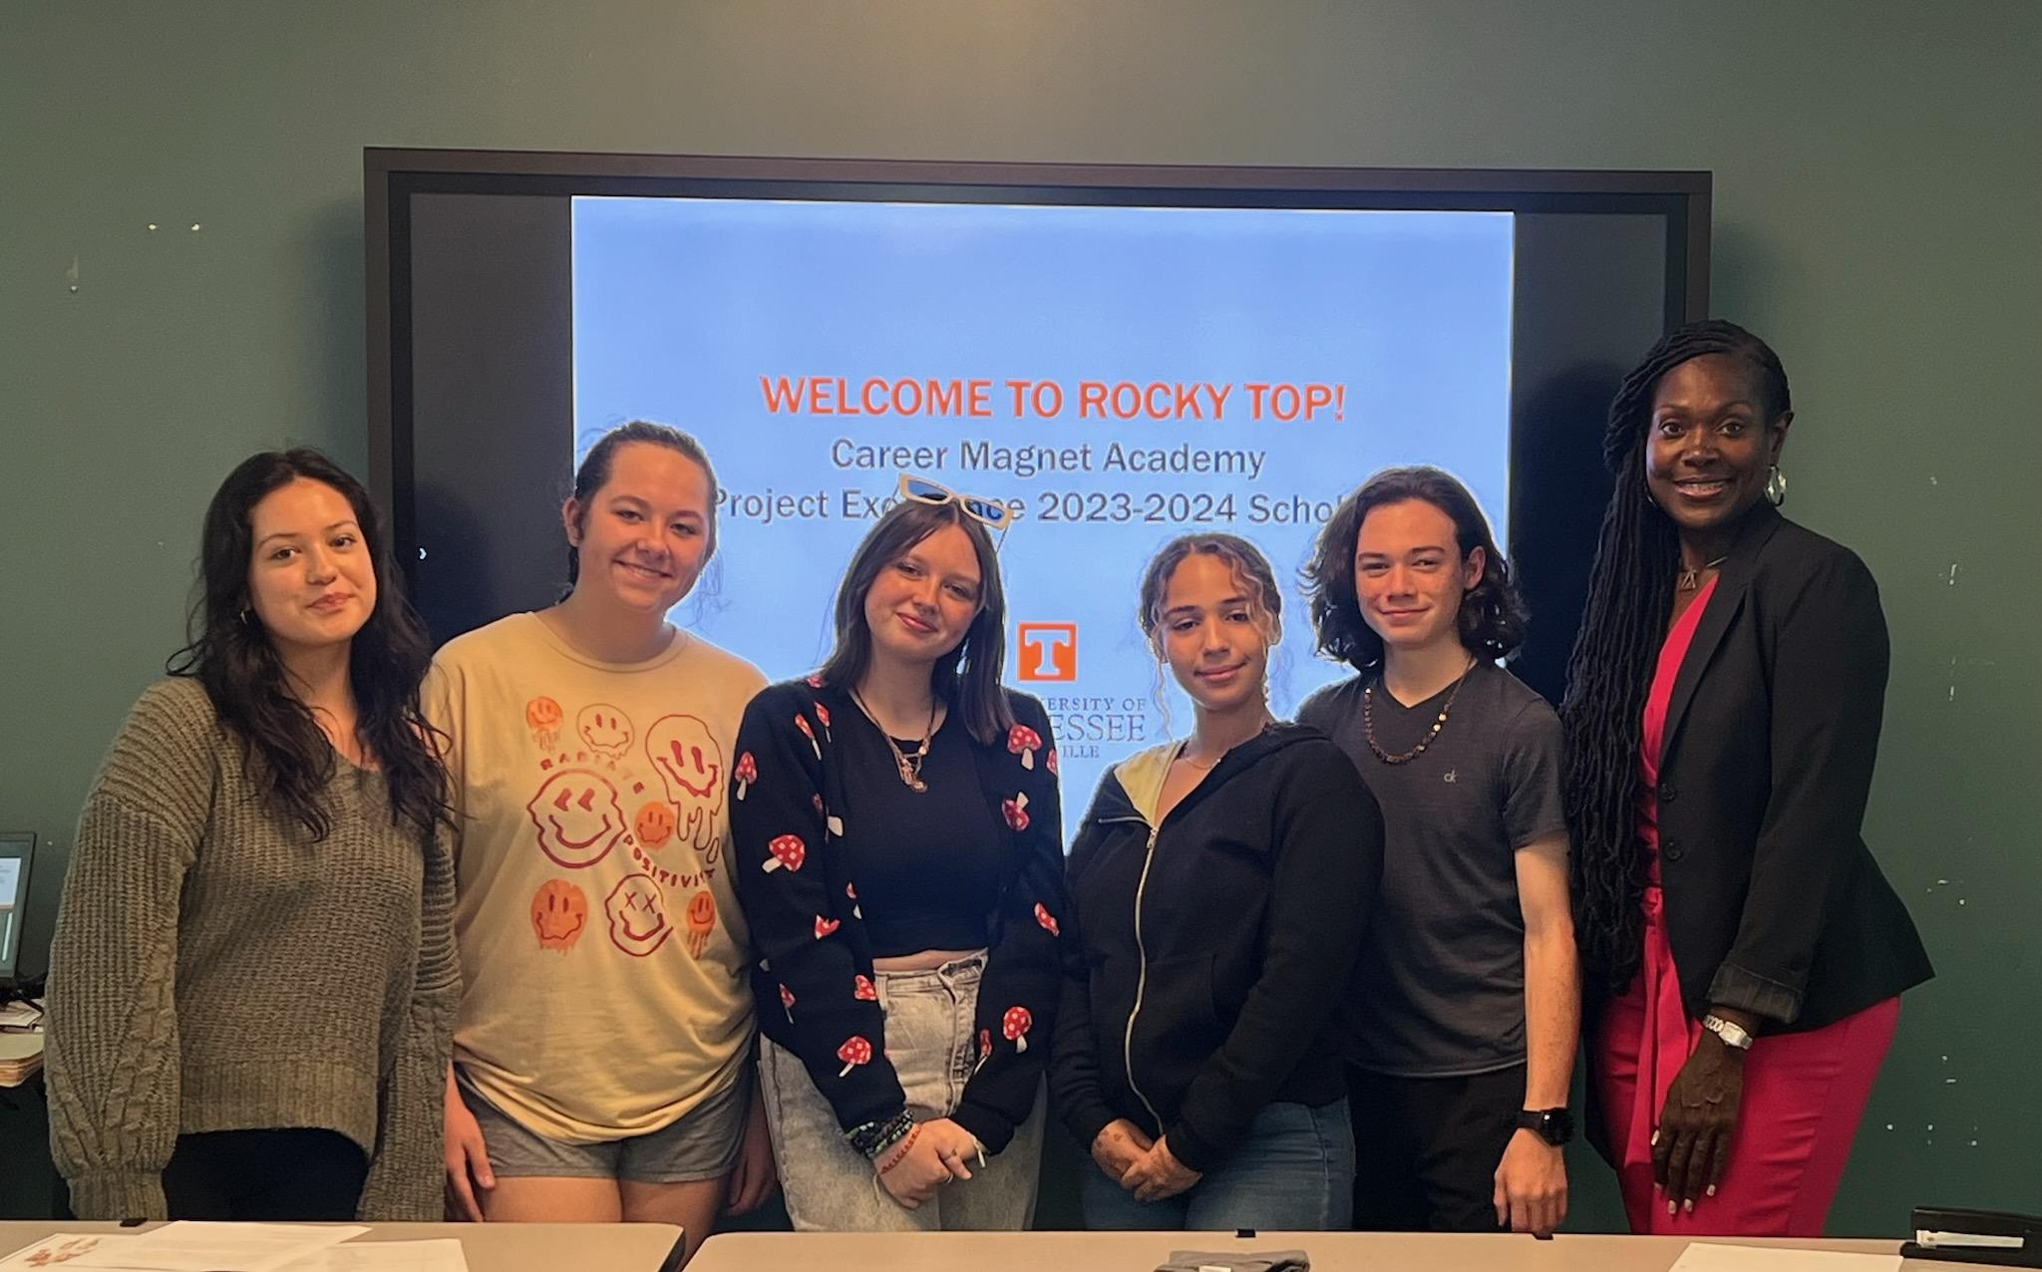
STUDENT CENTERED
Student-led clubs and organizations, student government, and tours
Notes:
Leanne

Slide 11
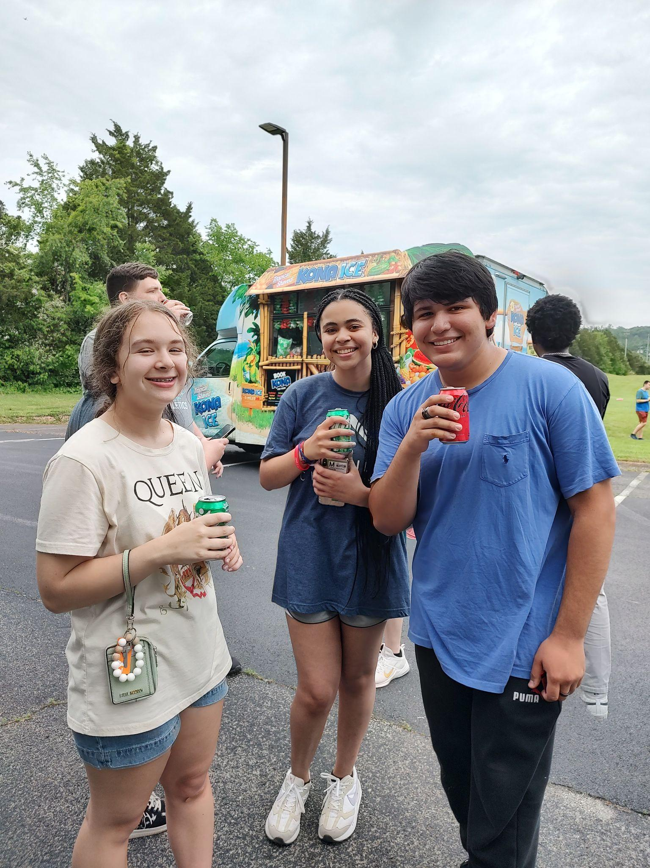
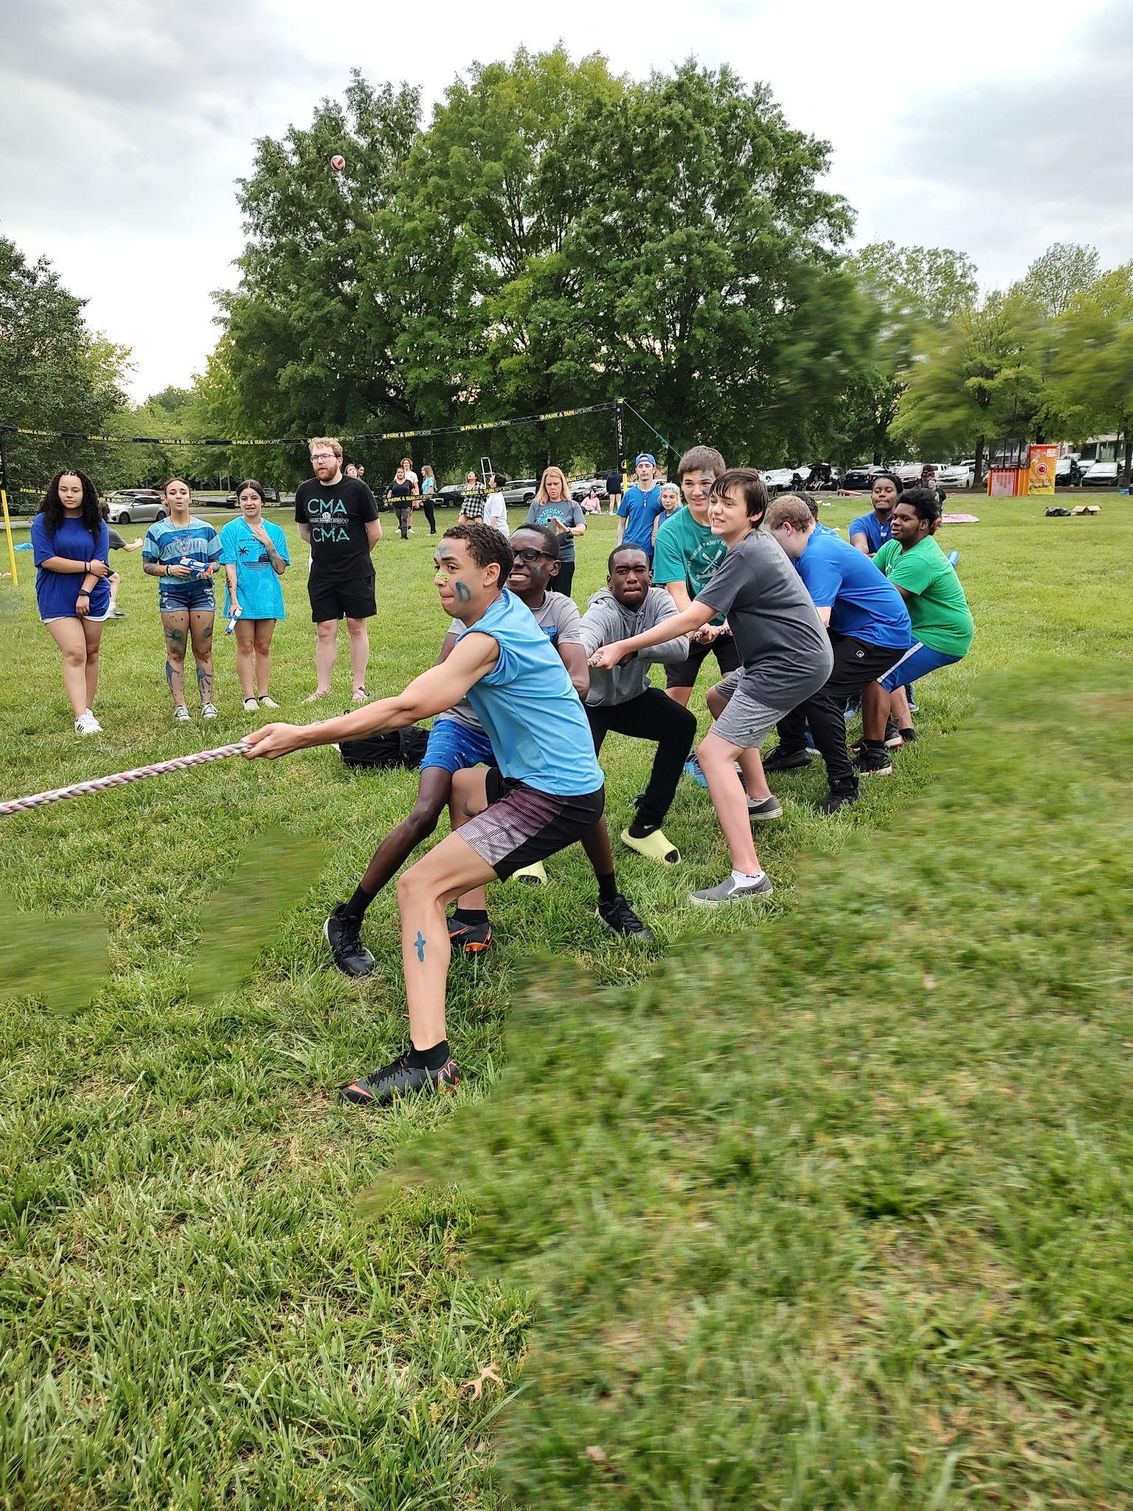
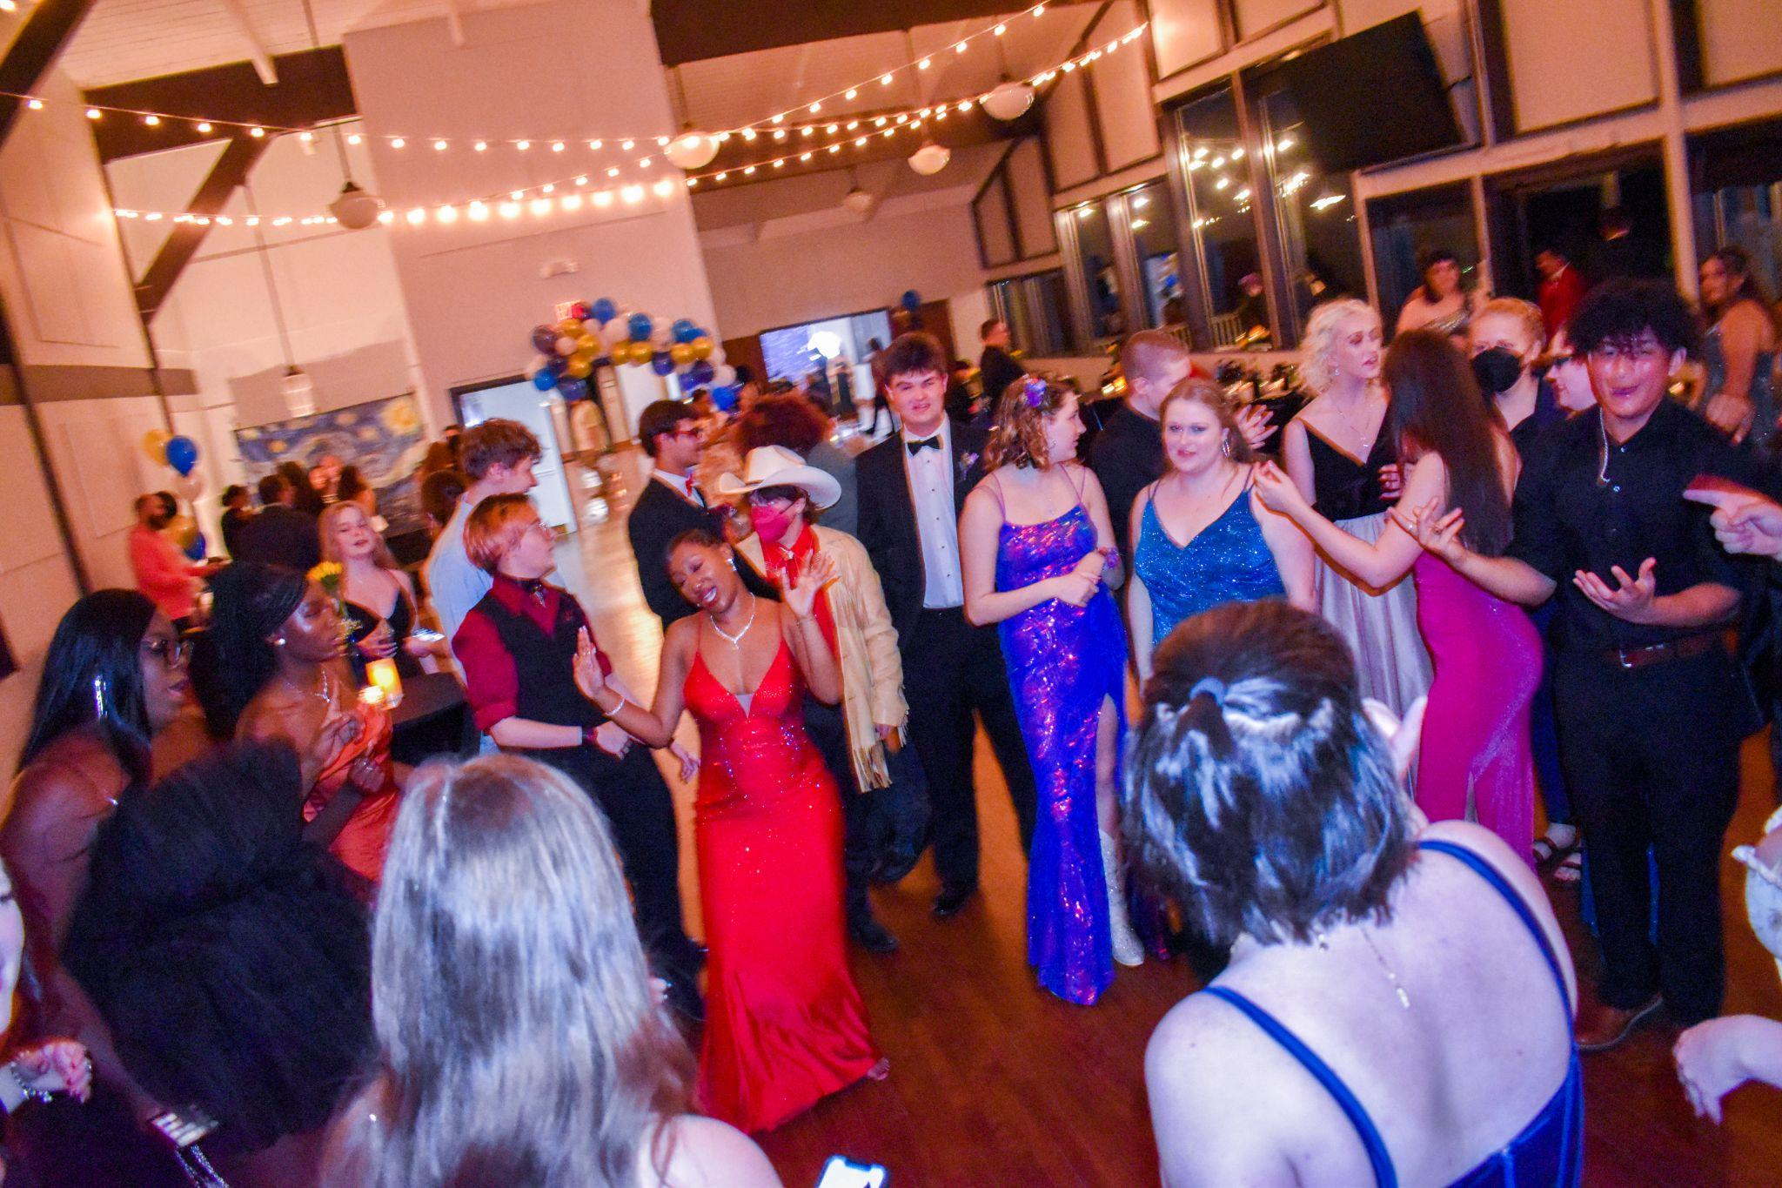
WOLFPACK FUN!
Clubs
Sports
Dances
Events
Field Experiences
Notes:
Leanne

Slide 12
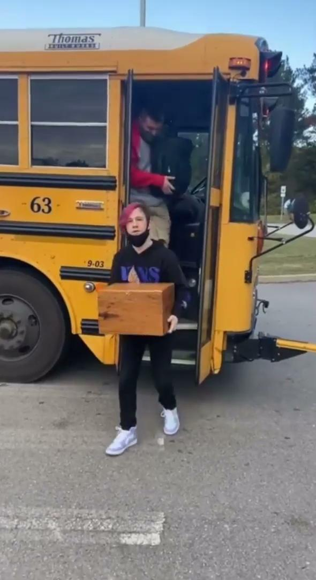
CLUBS and ORGANIZATIONS
Art Club
Book Club
Spanish Club
Guitar Club
Theater Club
Glee Club
Crochet Club
Gamers Club
Student Government
Ambassadors
National Honors Society
Philosophy Club
Science Club
Photography Club
Brain Bowl Club
American Sign Language Club
FBLA

Slide 13
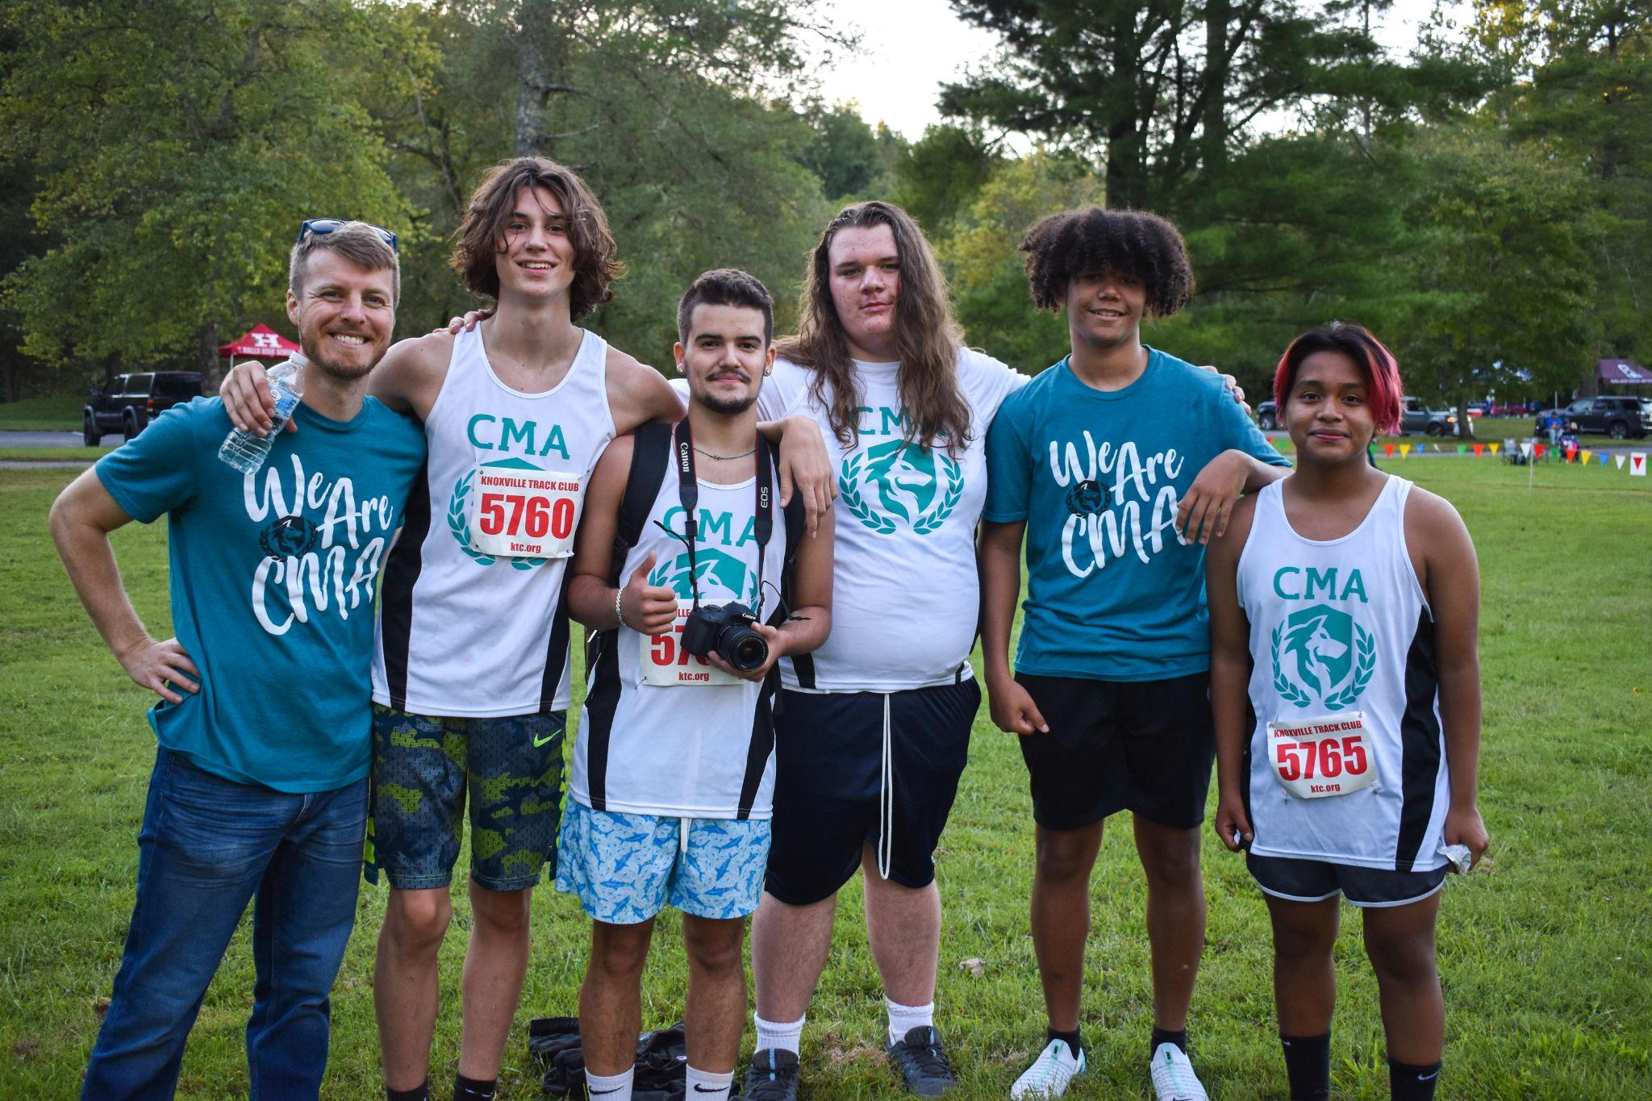
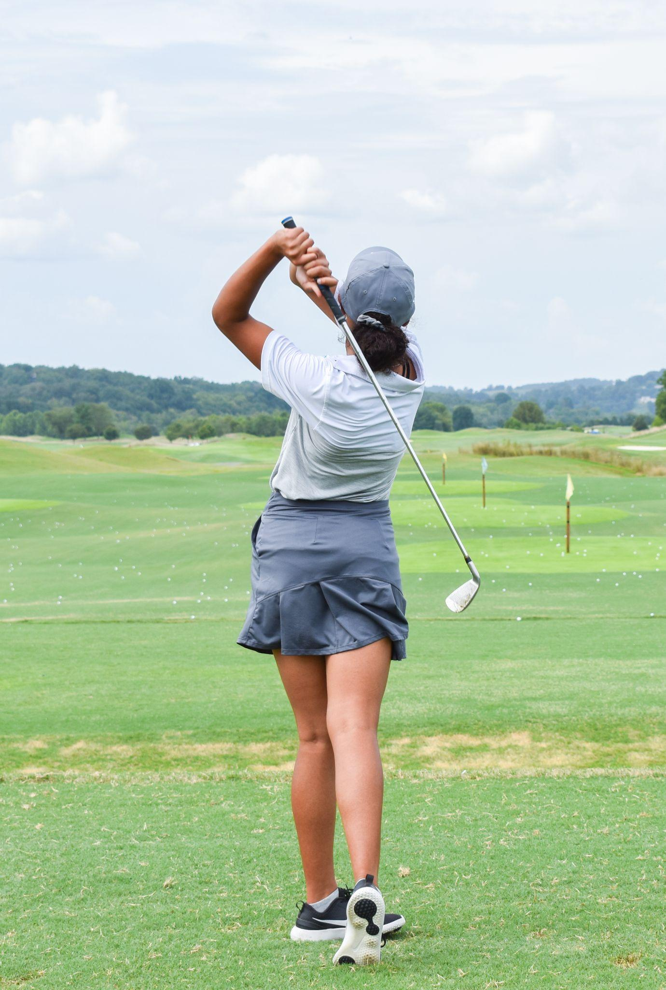
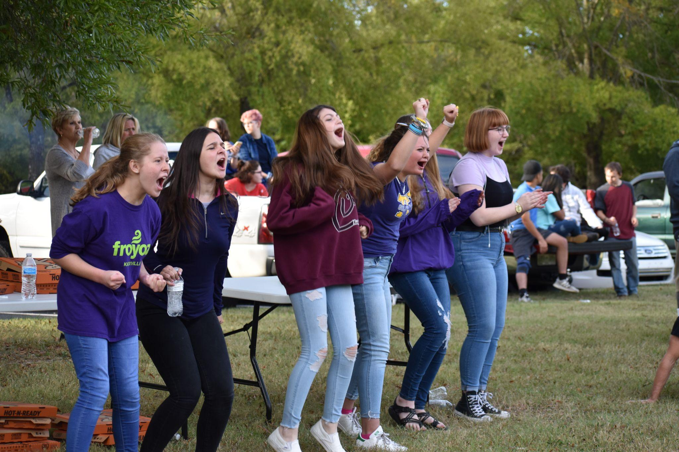
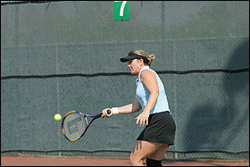
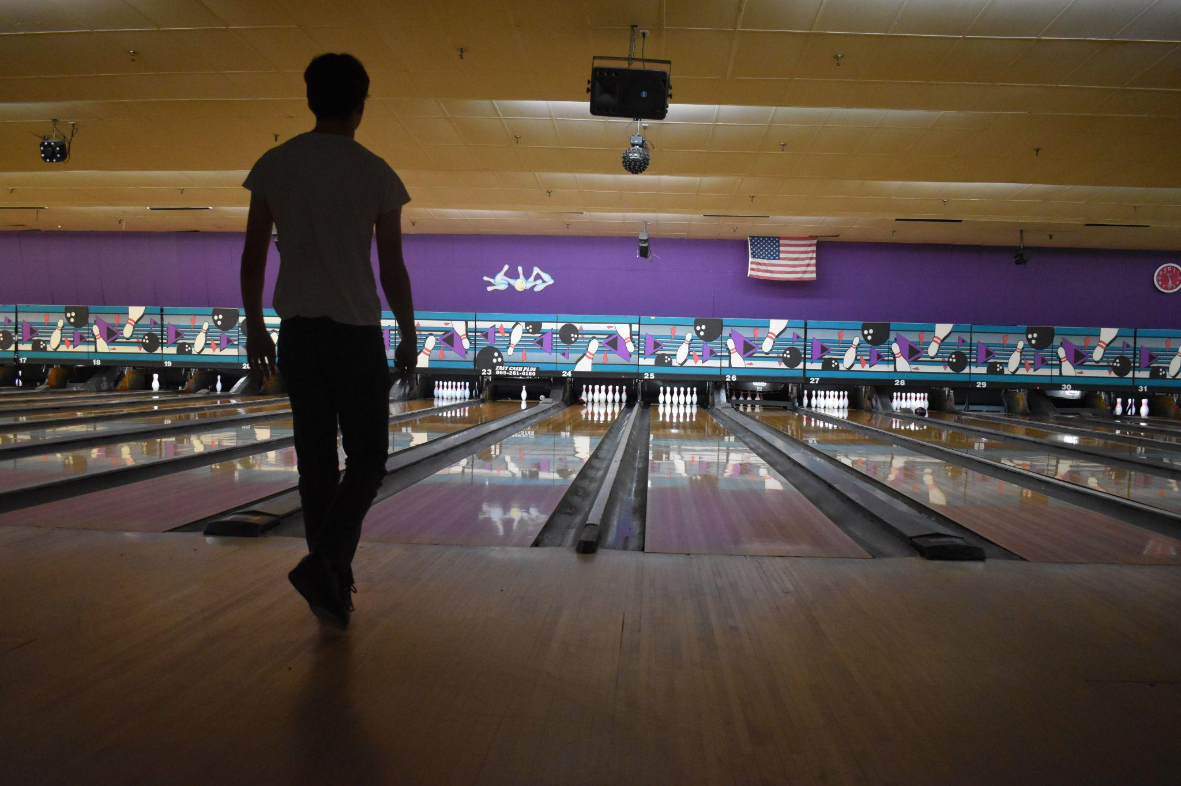
SPORTS
Notes:
Leanne

Slide 14

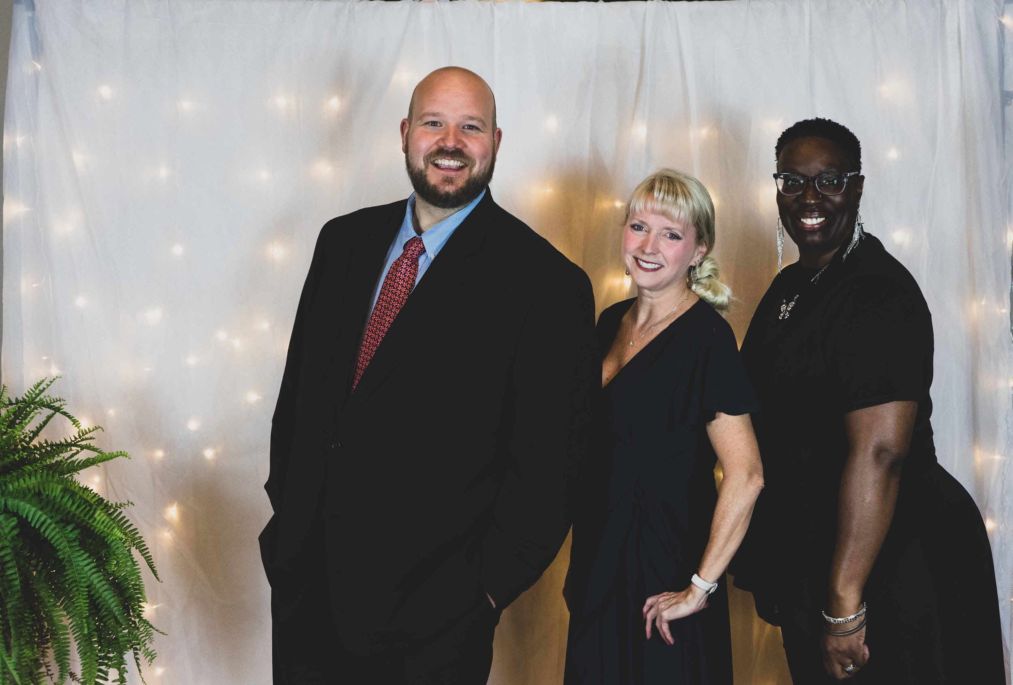
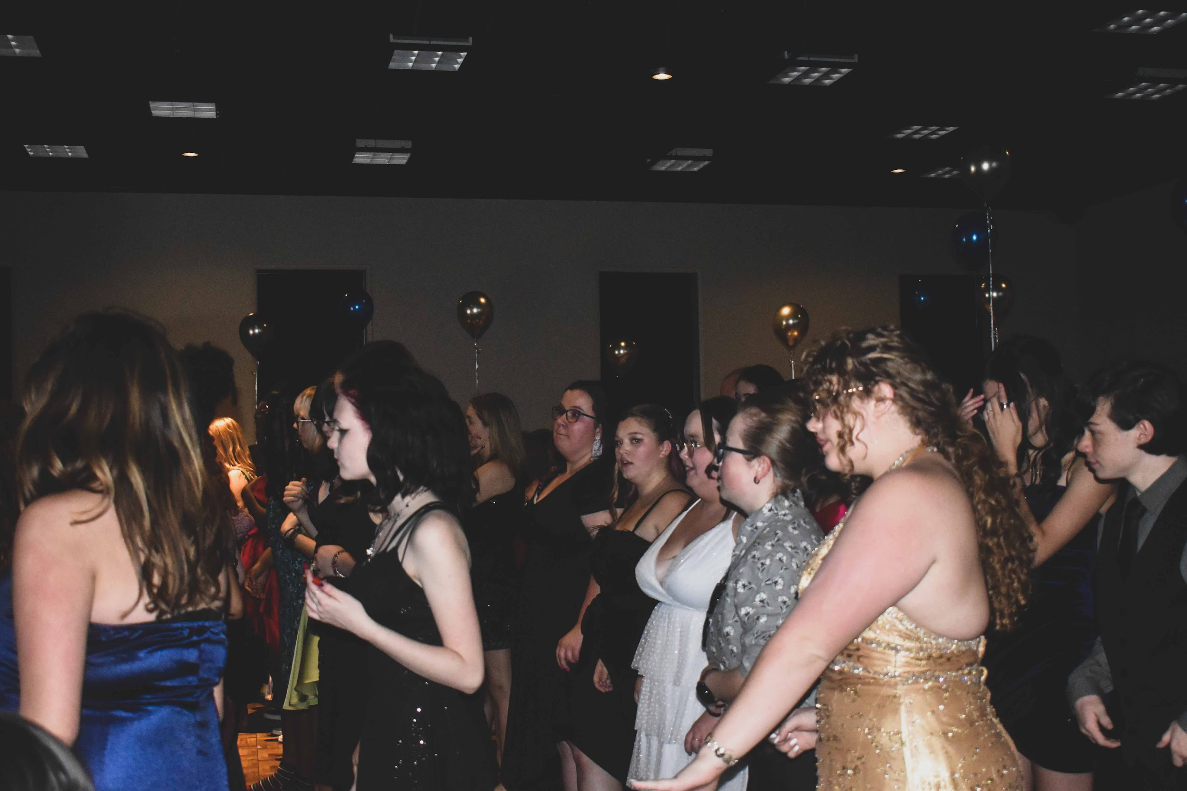
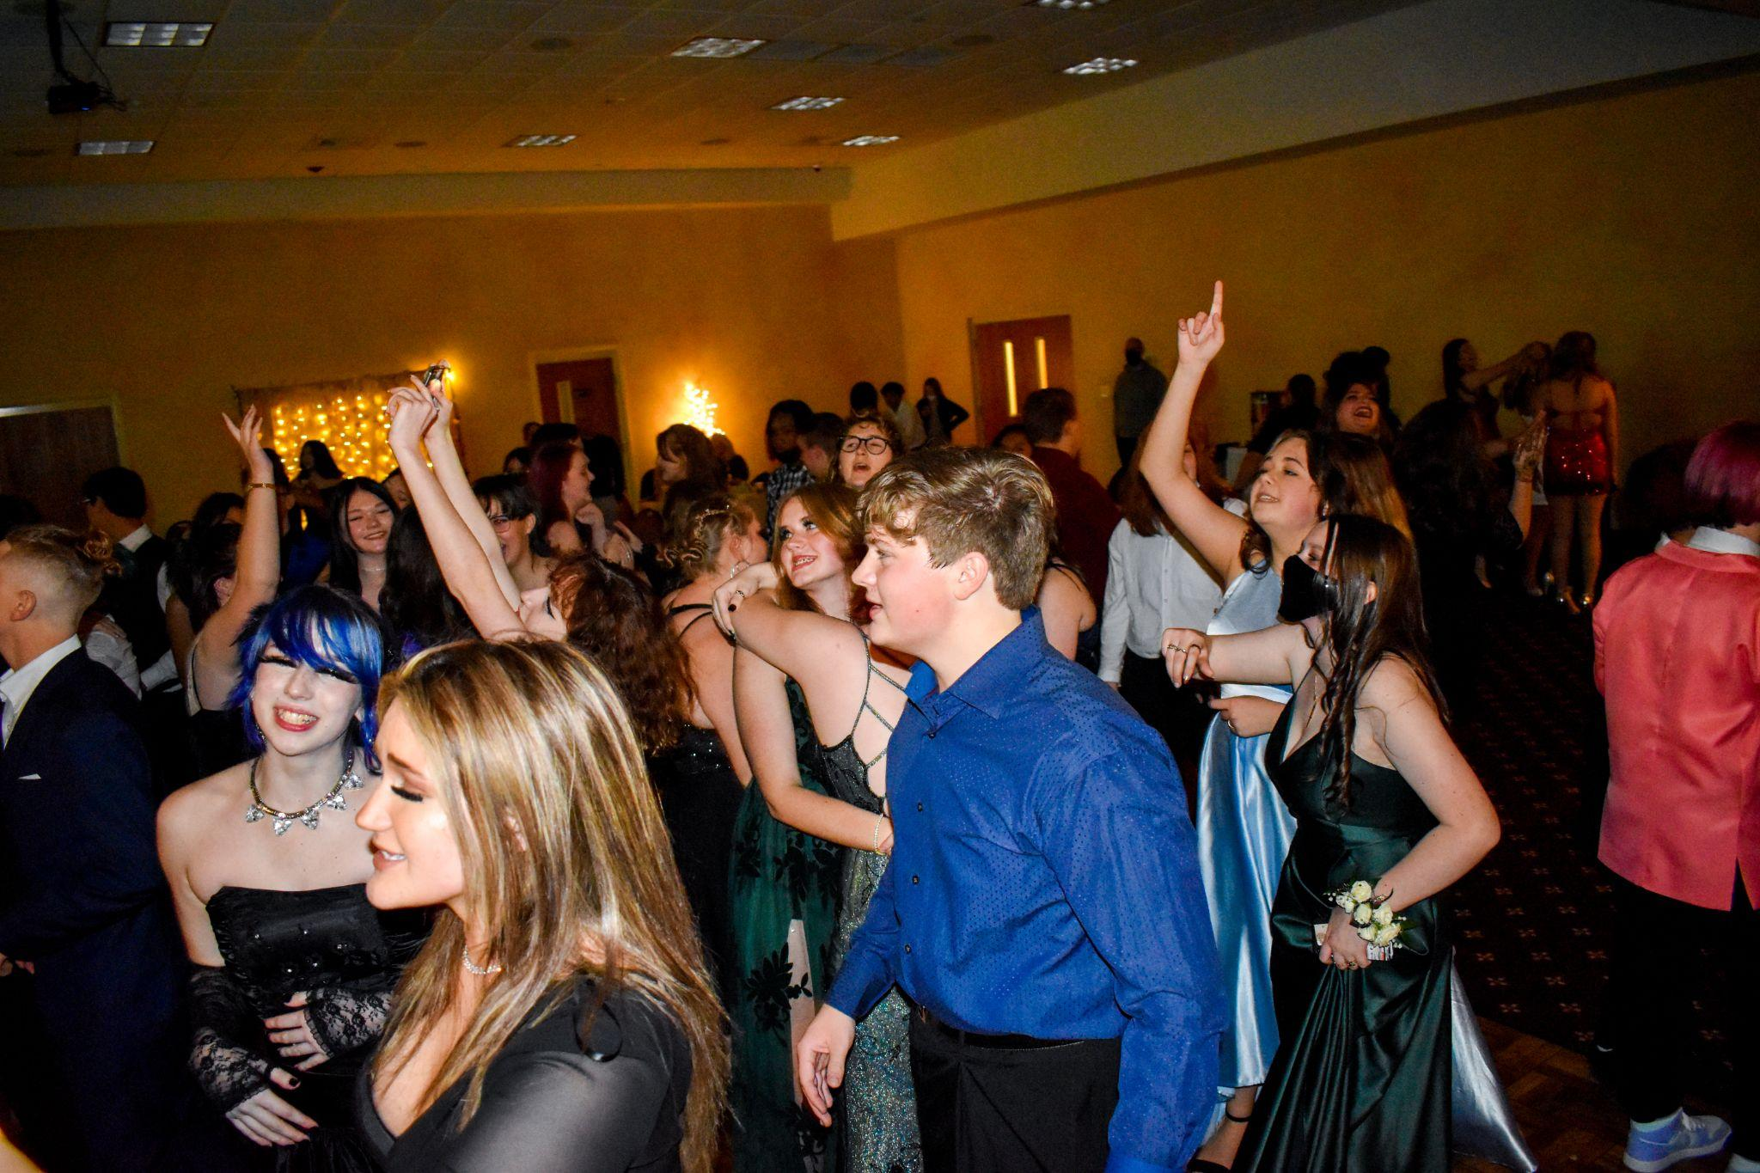
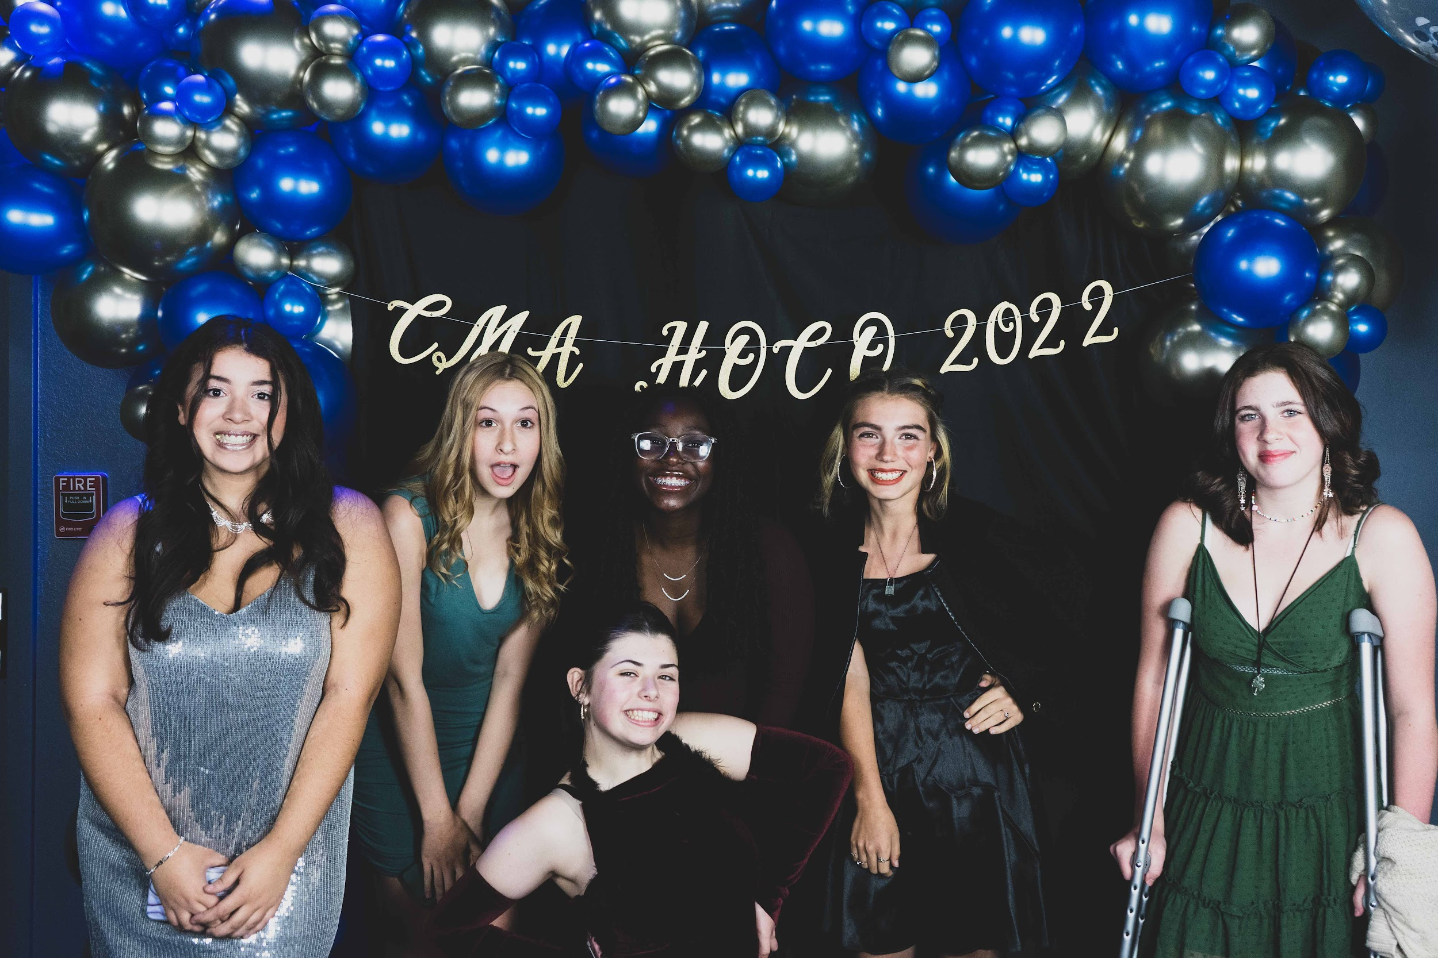
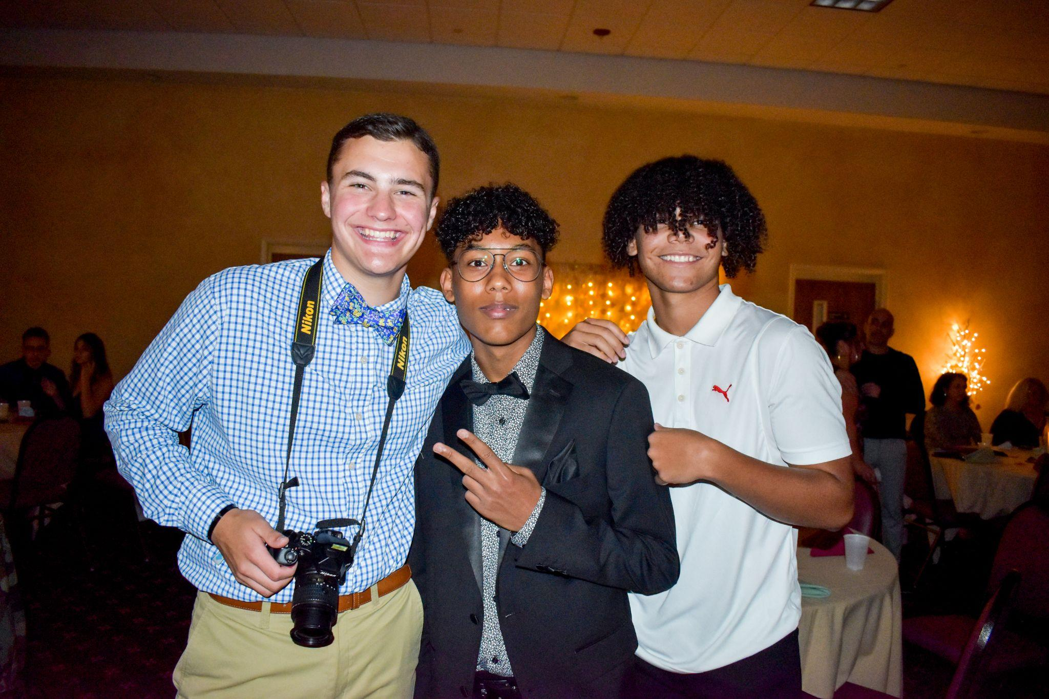
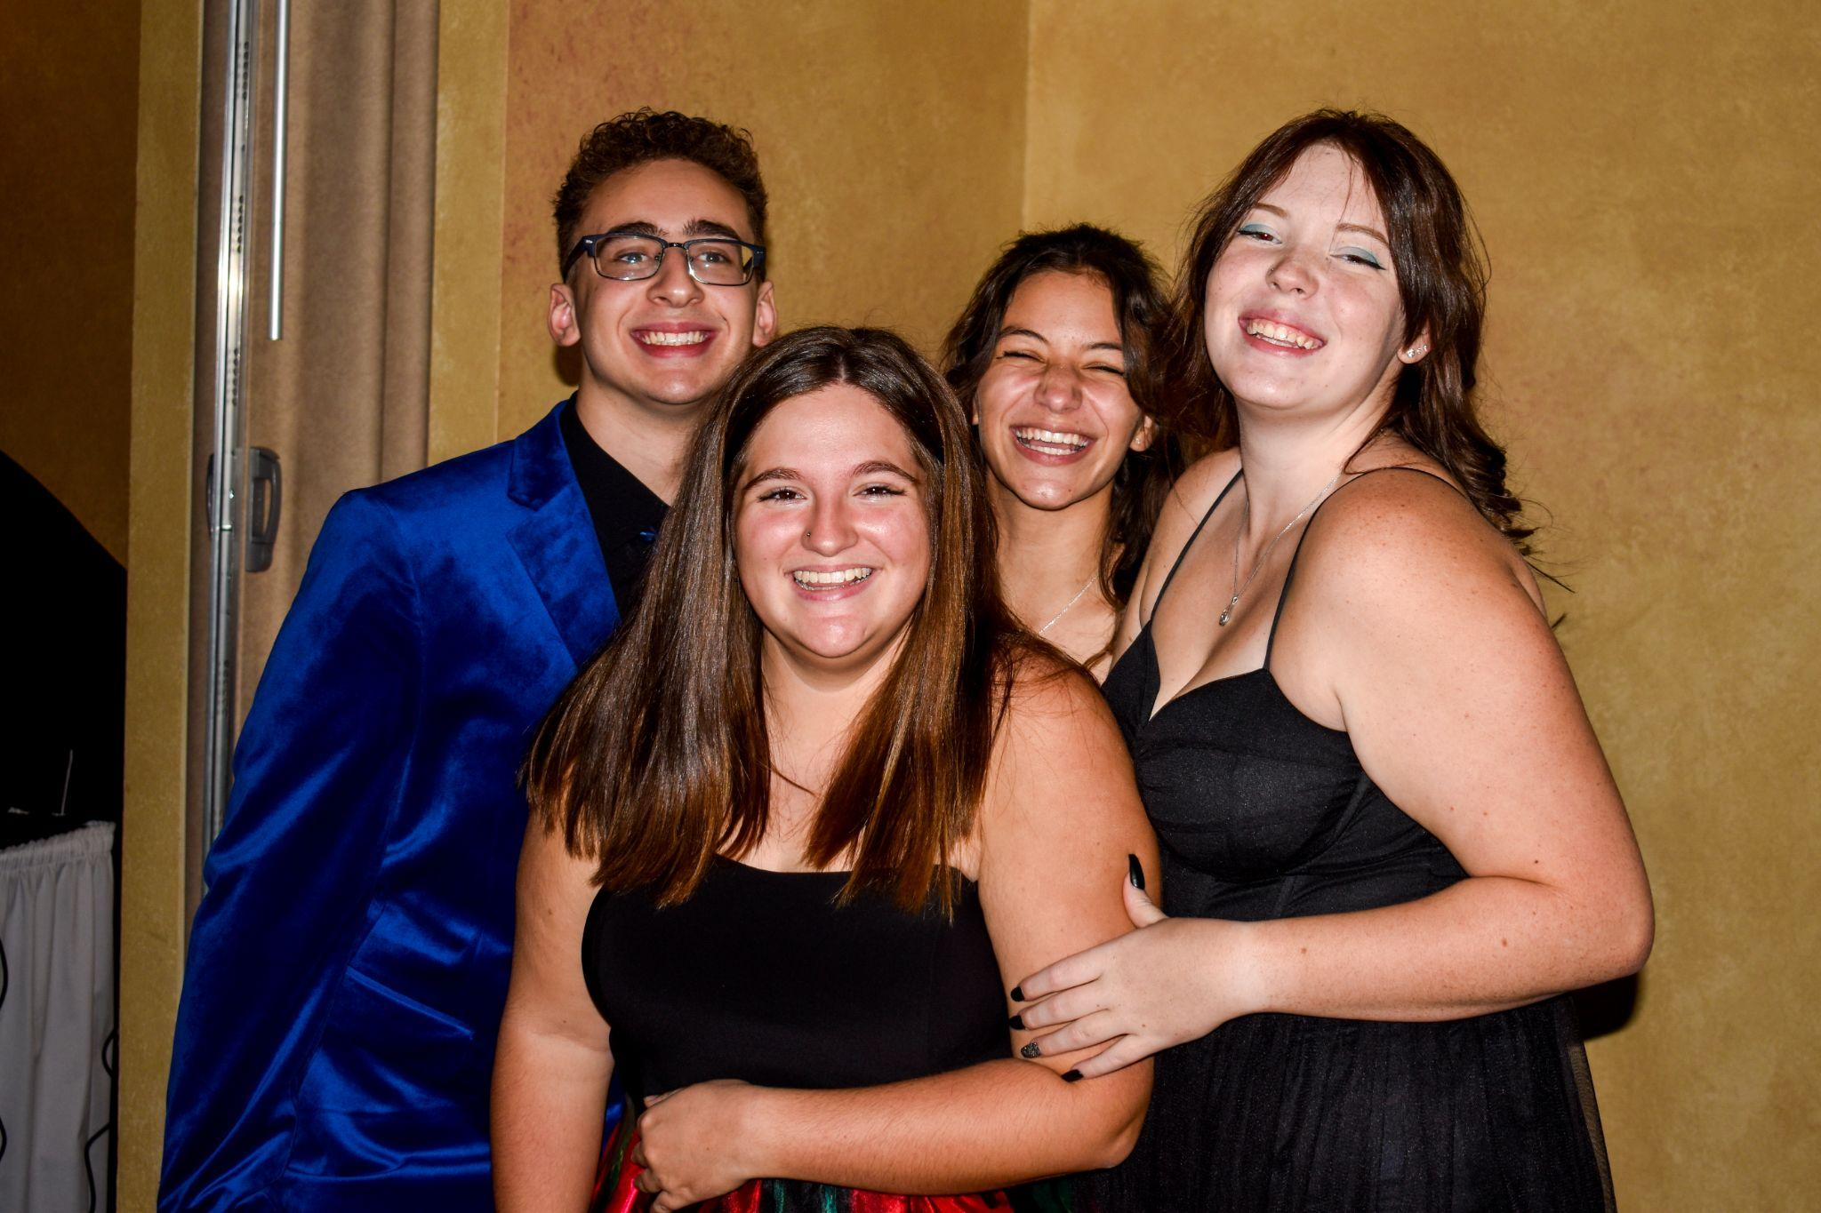
SCHOOL DANCES
Notes:
Leanne

Slide 15
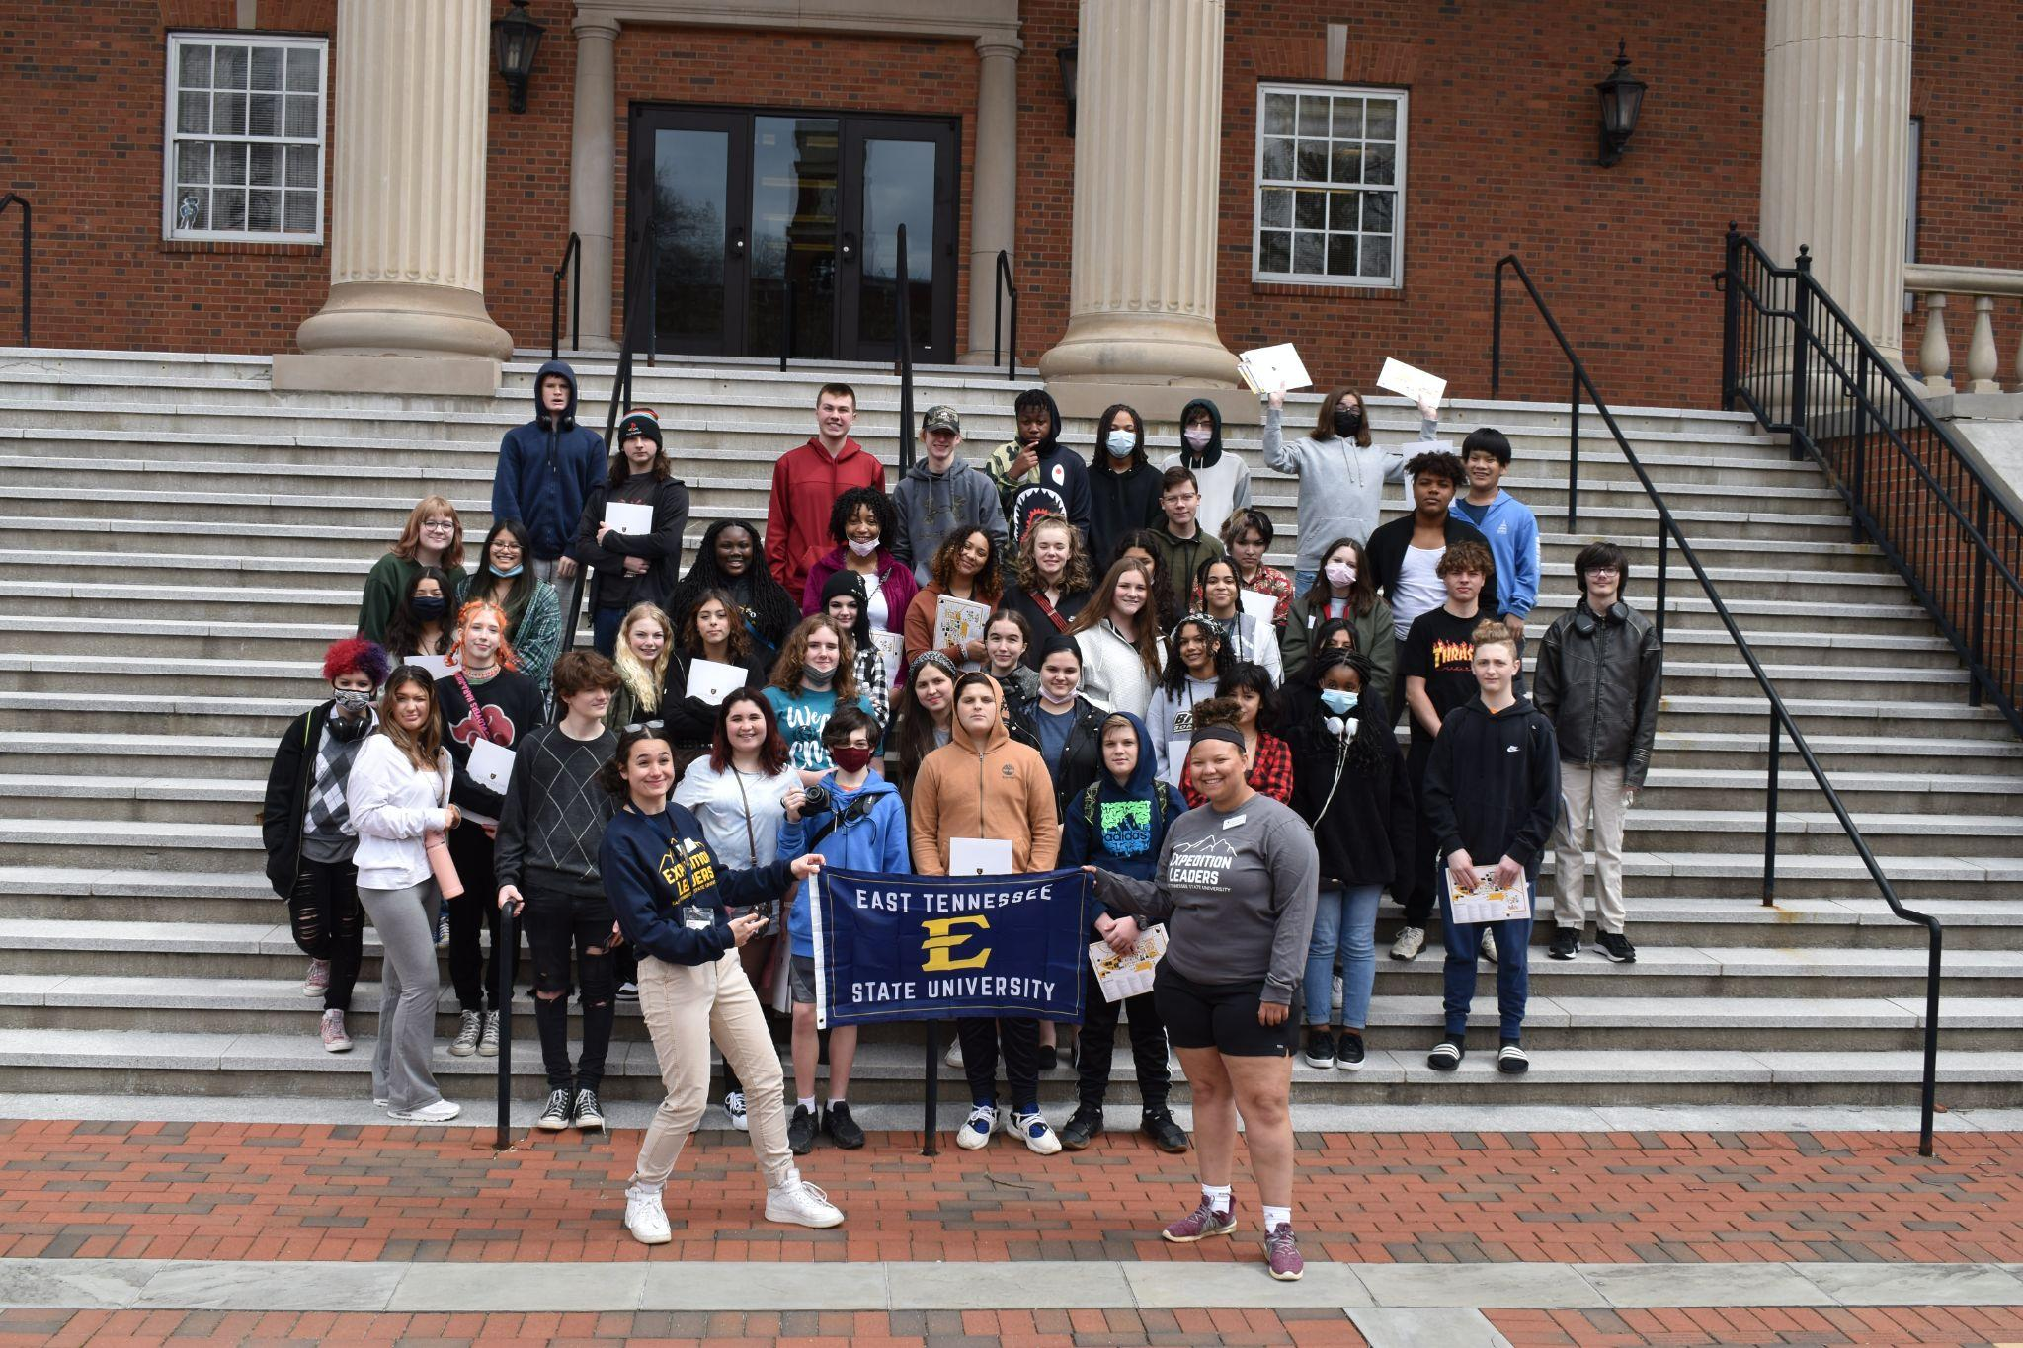
COLLEGE VISITS
University of Tennessee
Tennessee Tech
Lincoln Memorial University
Tusculum University
Walter State Community College
ETSU
TCAT
University of Tennessee-Chattanooga
Notes:
Leanne

Slide 16

Magnet Open House
November 14 6:00-7:00 pm
February 8 6:00-7:30 pm
Would your upcoming high school student benefit from an early college experience? Join us to learn more about what we do and how you can apply to be a part of it! Call for more info. 865-622-3800
Transfer window opens October 2, 2023 & closes February 20, 2024
Notes:
Leanne

Slide 17
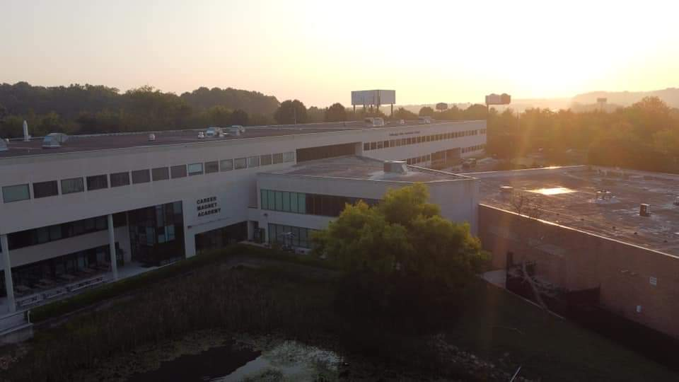
FOLLOW US
INSTAGRAM: @careermagnetacademy
TWITTER: @CMA_PSCC_KCS
FACEBOOK: @CMAPSCC
Notes:
Leanne

Slide 18
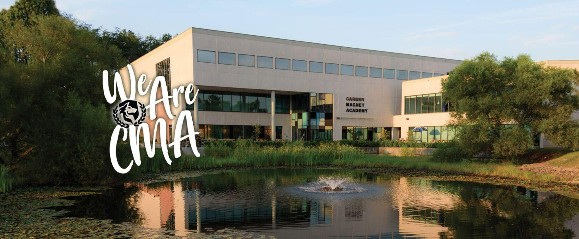
CONTACT US
PHONE:
865-622-3800
WEB:
https://www.knoxschools.org/careermagnet
EMAIL:
jennifer.sullivan@knoxschools.org
Assistant principal
ADDRESS:
7171 Strawberry Plains Pike
Notes:
Leanne

Slide 19
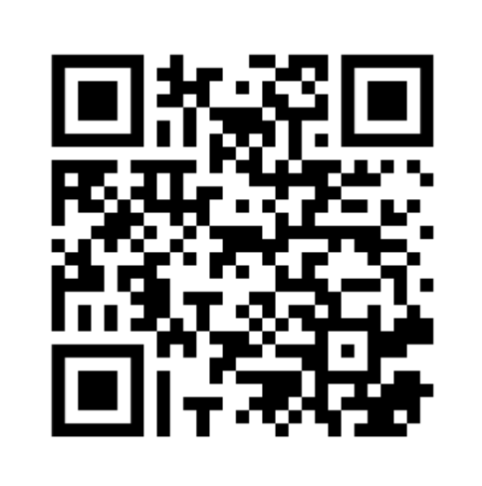
TRANSFER LINK
Notes:
Leanne

